Slide 1
Software Testing
Unit 1 :Basic Of Software Testing

Slide 2
SOFTWARE QUALITY Fundamentals
DEFINITION
Software quality is the degree of conformance to explicit or implicit requirements and expectations.
Explanation:
Explicit: clearly defined and documented
Implicit: not clearly defined and documented but indirectly suggested
Requirements: business/product/software requirements
Expectations: mainly end-user expectations

Slide 3
What is Software Testing
Finding defects
Trying to break the system
Finding and reporting defects
Demonstrating correct functionality
Demonstrating incorrect functionality
Demonstrating robustness, reliability, security,maintainability, …
Measuring performance, reliability, …
Evaluating and measuring quality
Proving the software correct
Executing pre-defined test cases
Automatic error detection

Slide 4
Definition Of Software Testing
Testing is the execution of programs with the intent of finding defects.
Testing is a the process of exercising a software component
using a selected set of test cases,
with the intent of revealing defects and evaluating quality.
Software testing is a technical investigation of a product, i.e.
an empirical search for quality-related information of value to a
project’s stakeholders

Slide 5
Bug, Fault & Failure
A person makes an Error
That creates a fault in software
That can cause a failure in operation
Error : An error is a human action that produces the incorrect result that
results in a fault.
Bug : The presence of error at the time of execution of the software.
Fault : State of software caused by an error.
Failure : Deviation of the software from its expected result. It is an event.
Defect :A defect is an error or a bug, in the application which is created. A programmer while designing and building the software can make mistakes or error. These mistakes or errors mean that there are flaws in the software. These are called defects.

Slide 6
Nature of errors
Categories of Software Errors:
User interface errors such as output errors or incorrect user messages.
Function errors
Hardware defects
Incorrect program version
Requirements errors
Design errors
Documentation errors
Architecture errors
Module interface errors
Performance errors
Logic errors such as calculation errors

Slide 7
Why do defects occur in software?
Software is written by human beings
􀂾 Who know something, but not everything
􀂾 Who have skills, but aren’t perfect
􀂾 Who don’t usually use rigorous methods
􀂾 Who do make mistakes (errors)
Under increasing pressure to deliver to strict deadlines
􀂾 No time to check, assumptions may be wrong
􀂾 Systems may be incomplete
Software is complex, abstract and invisible
􀂾 Hard to understand
􀂾 Hard to see if it is complete or working correctly
􀂾 No one person can fully understand large systems
􀂾 Numerous external interfaces and dependencies

Slide 8
Sources of defects
Education
􀂾 Developers does not understand well enough what he or she is doing
􀂾 Lack of proper education leads to errors in specification,design, coding, and testing
Communication
􀂾 Developers do not know enough
􀂾 Information does not reach all stakeholders
􀂾 Information is lost
Oversight
􀂾 Omitting to do necessary things
Transcription
􀂾 Developer knows what to do but simply makes a mistake
Process
􀂾 Process is not applicable for the actual situation
􀂾 Process places restrictions that cause errors

Slide 9
Objective of testing
To find defects before they cause a production system to fail.
To bring the tested software, after correction of the identified defects
and retesting, to an acceptable level of quality.
To perform the required tests efficiently and effectively, within the
limits budgetary and scheduling limitation.
To compile a record of software errors for use in error prevention (by corrective and preventive actions)

Slide 11
Test Plan
A test plan is a systematic approach to testing a system i.e. software. The plan typically contains a detailed understanding of what the eventual testing workflow will be.
Test Case
A test case is a specific procedure of testing a particular requirement.
It will include:
• Identification of specific requirement tested
• Test case success/failure criteria
• Specific steps to execute test
• Test Data

Slide 12
ENTRY CRITERIA
Entry Criteria for QA testing is defined as “Specific conditions or on-going activities that must be present before a process can begin”. In the Systems Development Life Cycle it also specifies which entry criteria are required at each phase. Additionally, it is also important to define the time interval or required amount of lead time that an entry criteria item is available to the process. Input can be divided into two categories. The first is what we receive from development. The second is what we produce that acts as input to later test process steps.
The type of required input from development includes:
Technical Requirements/Statement of Need
Design Document
Change Control
Turnover Document
The type of required input from test includes:
Evaluation of available software test tools
Test Strategy
Test Plan
Test Incident Reports
By referencing the Entry Exit Criteria matrix, we get the clarity of the deliverables expected from each phase. The matrix should contain “date required” and should be modified to meet the specific goals and requirements of each test effort based on size and complexity.

Slide 13
EXIT CRITERIA
Exit Criteria is often viewed as a single document concluding the end of a life cycle phase. Exit Criteria is defined as “The specific conditions or on-going activities that must be present before a life cycle phase can be considered complete. The life cycle specifies which exit criteria are required at each phase”. This definition identifies the intermediate deliverables, and allows us to track them as independent events.
The type of output from test includes:
Test Strategy
Test Plan
Test Scripts/Test Case Specifications
Test Logs
Test Incident Report Log
Test Summary Report/Findings Report
By identifying the specific Exit criteria, we are able to identify and plan how these steps and processes fit into the life cycle. All of the Exit Criteria listed above, less the Test Summary/Findings Report; act as Entry Criteria to alter process.

Slide 14
Who is a SoftwareTester??..
Software Tester is the one who performs testing and find bugs, if they exist in the tested application.

Slide 15
Skills Required for Tester
Communication skills
Domain knowledge
Desire to learn
Technical skills
Analytical skills
Planning
Integrity
Curiosity
Think from users perspective
Be a good judge of your product

Slide 16
Software Quality Concept
Quality : Quality means consistently meeting customer needs in terms of requirement, Cost and delivery schedule.
Quality of s/w is reasonably bug free, delivered on time and within budget, meets requirements and exceptions and is maintainable

Slide 17
Software Quality Concept
Quality Control: “All defined work products and Measurable Specifications” are compared with the output of each process.
Quality control focuses on operational technique and activities used to fulfill and verify requirement of quality.
- S/w quality involves – Series of inspection, reviews, and test used through out the s/w process.

Slide 18
Quality Assurance (QA): consist of Auditing and reporting procedure. Which are used to provide necessary data to management. In order to make decision.
Goal of Quality Assurance is to provide adequate confidence that a product or services is of the and quality expected by the customer.
If the data provided through quality assurance identify problems, then it is management’s responsibility to address the problems & apply the necessary resources to resole quality issues.

Slide 19
S/w Quality Assurance is planned and systematic way to evaluate quality of s/w product standards processes and procedures.
SQA includes the process of insuring that standers and procedures are established and are followed throughout the software acquisition Life cycle.
“ SQA consists of a means of monitoring the s/w engineering process and methods used to insure quality ”

Slide 20
Standards: Standards are the criteria’s to which the s/w product are compared.
Documentations Standards: Specify form and
Contents for planning, analysis and product documentation and consistency through out a project.
Design Standards: Specify forms and contents of design product. They provide rules and methods for translating the s/w requirements into the s/w design.
Code Standards : Specify the language in which code is to written and define any restrictions on use of language features.
They define legal language structures, style conversions, rules for data structure and interface.
Procedure: Expected steps to be followed in carrying out a process.

Slide 21
Cost Of Quality
Cost of Quality is the total amount the company spends to achieve quality of product.
Quality of cost is divided into cost associate with prevention, appraisal and failure.
1. Prevention Cost: Quality Panning, Formal Technical reviews, test equipments, staff training.
2. Appraisal Cost: Equipment Maint. Testing.In process and Inter process Inspection.
3. Failure Cost : It will not consider if there is no defect before shipping.

Slide 22
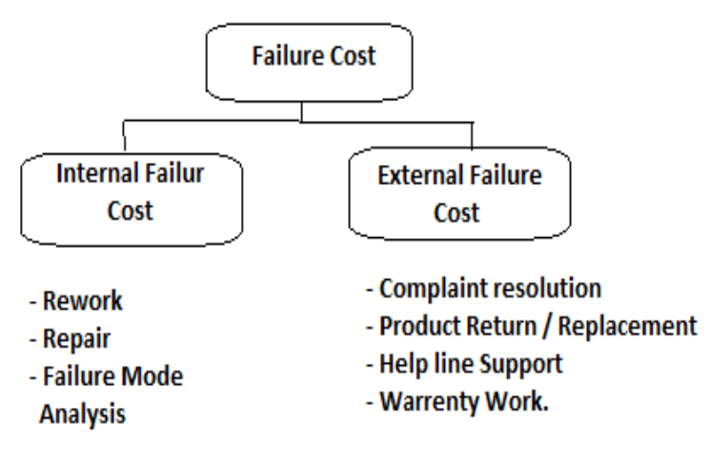

Slide 23
Verification & Validation
Verification
Are you building the product right?
Software must conform to its specification
Validation
Are you building the right product?
Software should do what the user really requires

Slide 24
What is Verification?
Definition : The process of evaluating software to determine whether the products of a given development phase satisfy the conditions imposed at the start of that phase.
Verification is a static practice of verifying documents, design, code and program. It includes all the activities associated with producing high quality software: inspection, design analysis and specification analysis. It is a relatively objective process.
Verification will help to determine whether the software is of high quality, but it will not ensure that the system is useful. Verification is concerned with whether the system is well-engineered and error-free.
Methods of Verification : Static Testing
Walkthrough
Inspection
Review

Slide 25
What is Validation?
Definition: The process of evaluating software during or at the end of the development process to determine whether it satisfies specified requirements.
Validation is the process of evaluating the final product to check whether the software meets the customer expectations and requirements. It is a dynamic mechanism of validating and testing the actual product.
Methods of Validation : Dynamic Testing
Testing
End Users

Slide 26
Verification | Validation
1. Verification is a static practice of verifying documents, design, code and program. | 1. Validation is a dynamic mechanism of validating and testing the actual product.
2. It does not involve executing the code. | 2. It always involves executing the code.
3. It is human based checking of documents and files. | 3. It is computer based execution of program.
4. Verification uses methods like inspections, reviews, walkthroughs, and Desk-checking etc. | 4. Validation uses methods like black box (functional) testing, gray box testing, and white box (structural) testing etc.
5. Verification is to check whether the software conforms to specifications. | 5. Validation is to check whether software meets the customer expectations and requirements.
6. It can catch errors that validation cannot catch. It is low level exercise. | 6. It can catch errors that verification cannot catch. It is High Level Exercise.
7. Target is requirements specification, application and software architecture, high level, complete design, and database design etc. | 7. Target is actual product-a unit, a module, a bent of integrated modules, and effective final product.
8. Verification is done by QA team to ensure that the software is as per the specifications in the SRS document. | 8. Validation is carried out with the involvement of testing team.
9. It generally comes first-done before validation. | 9. It generally follows after verification.

Slide 27
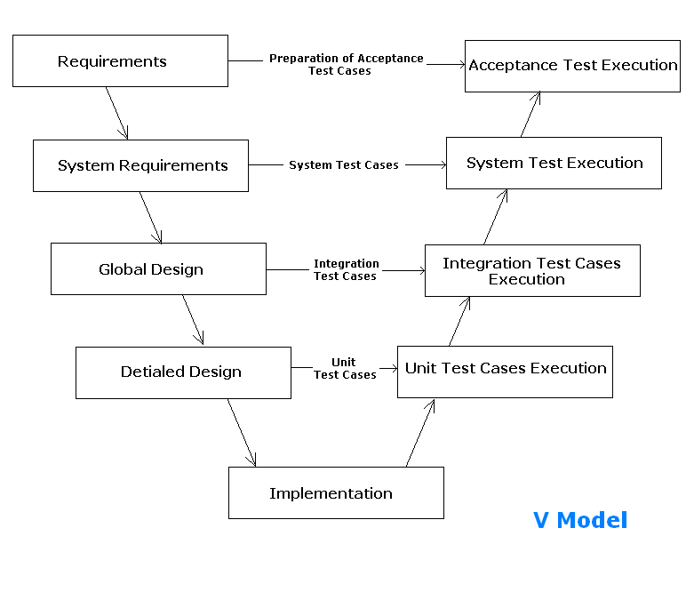

Slide 28
In the V-Model software development life cycle different steps are followed however here we will taking a most common type of V-model example. The V-model typically consist of the following phases:
Unit Testing: Preparation of Unit Test Cases
2. Integration Testing: Preparation of Integration Test Cases
3. System Testing: Preparation of System test cases
4. Acceptance Testing: Preparation of Acceptance Test Cases

