Slide 1
Chapter 3
Levels Of Testing And Special Tests

Slide 2
Levels Of Testing

Slide 3
Unit Testing
Unit Testing is a level of software testing where individual units/ components of a software are tested. The purpose is to validate that each unit of the software performs as designed.
Unit Testing is the first level of testing and is performed prior to Integration Testing.
A unit is the smallest testable part of software. It usually has one or a few inputs and usually a single output.
It is executed by the Developer.
Unit Testing is performed by using the White Box Testing method
Example: - A function, method, Loop or statement in program is working fine.

Slide 4
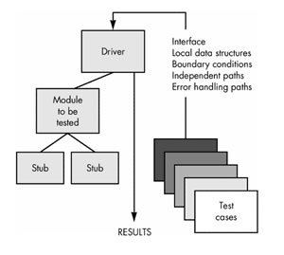

Slide 5
Drivers
Drivers are used in bottom-up integration testing approach.
It can simulate the behavior of upper-level module that is not integrated yet.
Drivers modules act as the temporary replacement of module and act as the actual products.
Drivers are also used for interact with external system and usually complex than stubs.
Driver: Calls the Module to be tested.
Now suppose you have modules B and C ready but module A which calls functions from module B and C is not ready so developer will write a dummy piece of code for module A which will return values to module B and C. This dummy piece of code is known as driver.

Slide 6
Stubs
Stubs are used in top down integration testing.
It can simulate the behavior of lower-level module that are not integrated.
They are act as a temporary replacement of module and provide same output as actual product.
When needs to intact with external system then also stubs are used.
Stub: Is called by the Module under Test.
Assume you have 3 modules, Module A, Module B and module C. Module A is ready and we need to test it, but module A calls functions from Module B and C which are not ready, so developer will write a dummy module which simulates B and C and returns values to module A. This dummy module code is known as stub.

Slide 7
 | Stub | Driver
Type | Dummy codes | Dummy codes
Description | Routines that don’t actually do anything except declare themselves and the parameters they accept. The rest of the code can then take these parameters and use them as inputs | Routines that don’t actually do anything except declare themselves and the parameters they accept. The rest of the code can then take these parameters and use them as inputs
Used in | Top Down Integration | Bottom Up Integration
Purpose | To allow testing of the upper levels of the code, when the lower levels of the code are not yet developed. | To allow testing of the lower levels of the code, when the upper levels of the code are not yet developed.

Slide 8
Benefits
Unit testing increases confidence in changing/ maintaining code. If good unit tests are written and if they are run every time any code is changed, we will be able to promptly catch any defects introduced due to the change.
Codes are more reusable.
Development is faster.
The cost of fixing a defect detected during unit testing is lesser in comparison to that of defects detected at higher levels.
Debugging is easy.

Slide 9
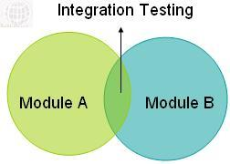
Integration Testing
Integration Testing is a level of software testing where individual units are combined and tested as a group.
In integration Testing, individual software modules are integrated logically and tested as a group.
Integration testing tests integration or interfaces between components, interactions to different parts of the system such as an operating system, file system and hardware or interfaces between systems.
As displayed in the image below when two different modules ‘Module A’ and ‘Module B’ are integrated then the integration testing is done.

Slide 10
Integration Testing Approaches

Slide 11
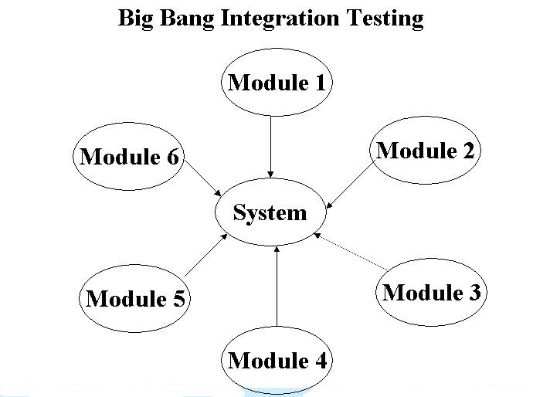
Big Bang integration testing
In Big Bang integration testing all components or modules are integrated simultaneously, after which everything is tested as a whole. As per the below image all the modules from ‘Module 1’ to ‘Module 6’ are integrated simultaneously then the testing is carried out.

Slide 12
Pros And Cons
Convenient for small systems.
Fault Localization is difficult.
Since all modules are tested at once, high risk critical modules are not isolated and tested on priority.
Since the integration testing can commence only after "all" the modules are designed, testing team will have less time for execution in the testing phase.

Slide 13
Incremental Approach:
In this approach, testing is done by joining two or more modules that are logically related. Then the other related modules are added and tested for the proper functioning. Process continues until all of the modules are joined and tested successfully.
This process is carried out by using dummy programs called Stubs and Drivers. Stubs and Drivers do not implement the entire programming logic of the software module but just simulate data communication with the calling module.
Stub: Is called by the Module under Test.
Driver: Calls the Module to be tested.

Slide 14
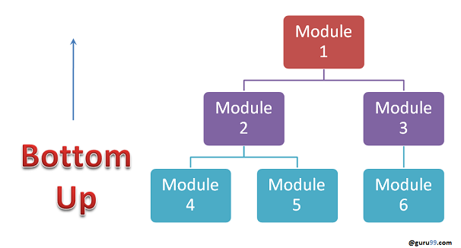
Bottom up Integration
In the bottom up strategy, each module at lower levels is tested with higher modules until all modules are tested.
It takes help of Drivers for testing

Slide 15
Advantages:
Fault localization is easier.
No time is wasted waiting for all modules to be developed unlike Big-bang approach
Disadvantages:
Critical modules (at the top level of software architecture) which control the flow of application are tested last and may be prone to defects.
Early prototype is not possible

Slide 16
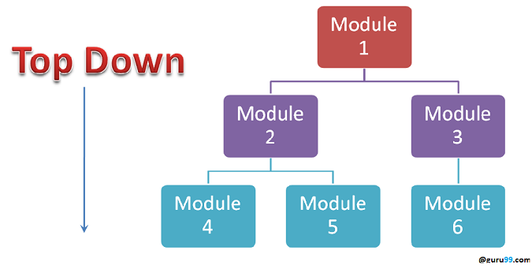
Top down Integration:
In Top to down approach, testing takes place from top to down following the control flow of the software system.
Takes help of stubs for testing.

Slide 17
Advantages:
Fault Localization is easier.
Possibility to obtain an early prototype.
Critical Modules are tested on priority; major design flaws could be found and fixed first.
Disadvantages:
Needs many Stubs.
Modules at lower level are tested inadequately.

Slide 18
Unit Testing | Integration Testing
Unit testing is a type of testing to check if the small piece of code is doing what it is suppose to do. | Integration testing is a type of testing to check if different pieces of the modules are working together.
Unit testing checks a single component of an application. | The behavior of integration modules is considered in the Integration testing.
The scope of Unit testing is narrow, it covers the Unit or small piece of code under test. Therefore while writing a unit test shorter codes are used that target just a single class. | The scope of Integration testing is wide, it covers the whole application under test and it requires much more effort to put together.
Unit tests should have no dependencies on code outside the unit tested. | Integration testing is dependent on other outside systems like databases, hardware allocated for them etc.
This is first type of testing is to be carried out in Software testing life cycle and generally executed by developer. | This type of testing is carried out after Unit testing and before System testing and executed by the testing team.
Unit testing is not further sub divided into different types. | Integration testing is further divided into different types as follows: Top-down Integration, Bottom-Up Integration and so on.
Unit testing is starts with the module specification. | Integration testing is starts with the interface specification.
The detailed visibility of the code is comes under Unit testing. | The visibility of the integration structure is comes under Integration testing.
Unit testing mainly focus on the testing the functionality of individual units only and does not uncover the issues arises when different modules are interacting with each other. | Integration testing is to be carried out to discover the the issues arise when different modules are interacting with each other to build overall system.
The goal of Unit testing is to test the each unit separately and ensure that each unit is working as expected. | The goal of Integration testing is to test the combined modules together and ensure that every combined modules are working as expected.
Unit testing comes under White box testing type. | Integration testing is comes under both Black box and White box type of testing.

Slide 19
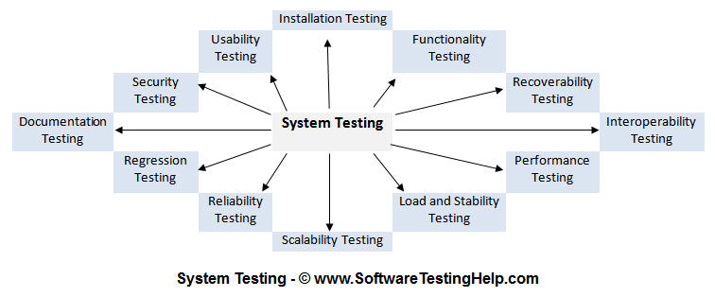
System Testing

Slide 20
The process of testing of an integrated hardware and software system to verify that the system meets its specified requirements.
It is performed when integration testing is completed.
It is mainly a black box type testing. This testing evaluates working of the system from a user point of view, with the help of specification document. It does not require any internal knowledge of system like design or structure of the code.
It contains functional and non-functional areas of application/product.
System testing is performed in the context of a System Requirement Specification (SRS) and/or a Functional Requirement Specifications (FRS). It is the final test to verify that the product to be delivered meets the specifications mentioned in the requirement document. It should investigate both functional and non-functional requirements.

Slide 21
It mainly focuses on following:
External interfaces
complex functionalities
Security
Recovery
Performance
Operator and user’s smooth interaction with system
Documentation
Usability
Load / Stress

Slide 22
Recovery Testing
Recovery testing is a type of non-functional testing technique performed in order to determine how quickly the system can recover after it has gone through system crash or hardware failure.
Recovery testing is the forced failure of the software to verify if the recovery is successful.
For example: When an application is receiving data from a network, unplug the connecting cable. After some time, plug the cable back in and analyze the application’s ability to continue receiving data from the point at which the network connection was broken.
Example: Restart the system while a browser has a definite number of sessions and check whether the browser is able to recover all of them or not.

Slide 23
Security Testing
Security testing is a testing technique to determine if an information system protects data and maintains functionality as intended
It also aims at verifying 6 basic principles as listed below:
Confidentiality
Integrity
Authentication
Authorization
Availability
Non-repudiation

Slide 24
Confidentiality
A security measure which protects against the disclosure of information to parties other than the intended recipient is by no means the only way of ensuring the security.
Integrity
Integrity of information refers to protecting information from being modified by unauthorized parties
Authentication
This might involve confirming the identity of a person, tracing the origins of an artifact, ensuring that a product is what its packaging and labeling claims to be, or assuring that a computer program is a trusted one

Slide 25
Authorization
The process of determining that a requester is allowed to receive a service or perform an operation.
Access control is an example of authorization.
Availability
Assuring information and communications services will be ready for use when expected.
Information must be kept available to authorized persons when they need it.
Non-repudiation (acknowledgment)
In reference to digital security, non-repudiation means to ensure that a transferred message has been sent and received by the parties claiming to have sent and received the message. Non-repudiation is a way to guarantee that the sender of a message cannot later deny having sent the message and that the recipient cannot deny having received the message.

Slide 26
Example :
A Student Management System is insecure if ‘Admission’ branch can edit the data of ‘Exam’ branch
An ERP system is not secure if DEO (data entry operator) can generate ‘Reports’
An online Shopping Mall has no security if customer’s Credit Card Detail is not encrypted
A custom software possess inadequate security if an SQL query retrieves actual passwords of its users

Slide 27
Performance Testing
Performance Testing is a type of testing to ensure software applications will perform well under their expected workload.
A software application's performance like its response time, reliability, resource usage and scalability do matter.
The goal of Performance Testing is not to find bugs but to eliminate performance bottlenecks.
The focus of Performance Testing is checking a software program's
Speed - Determines whether the application responds quickly
Scalability - Determines maximum user load the software application can handle.
Stability - Determines if the application is stable under varying loads

Slide 28
Performance Testing Process

Slide 29
1) Identify your testing environment –
Do proper requirement study & analyzing test goals and its objectives. Also determine the testing scope along with test Initiation Checklist. Identify the logical and physical production architecture for performance testing, identify the software, hardware and networks configurations required for kick off the performance testing. Compare the both test and production environments while identifying the testing environment. Get resolve the environment-related concerns if any, analyze that whether additional tools are required for performance testing. This step also helps to identify the probable challenges tester may face while performance testing.
2) Identify the performance acceptance criteria –
Identify the desired performance characteristics of the application like Response time, Throughput and Resource utilization.

Slide 30
3) Plan & design performance tests –
Planning and designing performance tests involves identifying key usage scenarios, determining appropriate variability across users, identifying and generating test data, and specifying the metrics to be collected. Ultimately, these items will provide the foundation for workloads and workload profiles. The output of this stage is prerequisites for Test execution are ready, all required resources, tools & test data are ready.
4) Configuring the test environment –
Prepare with conceptual strategy, available tools, designed tests along with testing environment before execution. The output of this stage is configured load-generation environment and resource-monitoring tools.
5) Implement test design –
According to test planning and design create your performance tests.

Slide 31
6) Execute the tests –
Collect and analyze the data.
Problem Investigation like bottlenecks (memory, disk, processor, process, cache, network, etc.) resource usage like (memory, CPU, network, etc.,)
Generate the Performance analysis reports containing all performance attributes of the application.
Based on the analysis prepare recommendation report.
Repeat the above test for the new build received from client after fixing the bugs and implementing the recommendations
7) Analyze Results, Report, and Retest
Consolidate, analyze and share test results.
Based on the test report re-prioritize the test & re-execute the same. If any specific test result within the specified metric limit & all results are between the thresholds limits then testing of same scenario on particular configuration is completed.

Slide 32
Test objectives frequently include the following:
Response time. For example, the product catalog must be displayed in less than 3 seconds.
Throughput. For example, the system must support 100 transactions per second.
Resource utilization. A frequently overlooked aspect is the amount of resources your application is consuming, in terms of processor, memory, disk input output (I/O), and network I/O.

Slide 33
Types of Performance Testing
Load test
Stress test
Data Volume Testing
Storage Testing

Slide 34
Load Testing
Load Testing is type of performance testing to check system with constantly increasing the load on the system until the time load is reaches to its threshold value.
Here Increasing load means increasing number of concurrent users, transactions & check the behavior of application under test.
It is normally carried out underneath controlled environment in order to distinguish between two different systems.
The main purpose of load testing is to monitor the response time and staying power of application when system is performing well under heavy load.
The successfully executed load testing is only if the specified test cases are executed without any error in allocated time.

Slide 35
Simple examples of load testing:
Testing printer by sending large job.
Editing a very large document for testing of word processor
Continuously reading and writing data into hard disk.
Running multiple applications simultaneously on server.
Testing of mail server by accessing thousands of mailboxes
In case of zero-volume testing & system fed with zero load.

Slide 36
Stress Testing
Stress Testing is performance testing type to check the stability of software when hardware resources are not sufficient like CPU, memory, disk space etc.
It is performed to find the upper limit capacity of the system and also to determine how the system performs if the current load goes well above the expected maximum.
Main parameters to focus during Stress testing are “Response Time” and “Throughput”.
Stress testing is Negative testing where we load the software with large number of concurrent users/processes which cannot be handled by the systems hardware resources. This testing is also known as Fatigue testing

Slide 37
Data Volume Testing
Volume testing is non-functional testing which refers to testing a software application with a large amount of data to be processed to check the efficiency of the application. The main goal of this testing is to monitor the performance of application under varying database volumes.
Volume testing determines how efficiently software performs with a large, projected amounts of data. It is also known as flood testing because the test floods the system with data.
Under Volume Testing large no. of. Data is populated in database and the overall software system's behavior is monitored. The objective is to check software application's performance under varying database volumes.

Slide 38
Storage Testing
Execution of our application under huge amounts of resources to estimate storage limitations to be handled by our application is called storage testing

Slide 39
Usability Testing
In usability testing basically the testers tests the ease with which the user interfaces can be used.
It tests that whether the application or the product built is user-friendly or not.
Usability Testing is a black box testing technique.
Usability testing also reveals whether users feel comfortable with your application or Web site according to different parameters – the flow, navigation and layout, speed and content – especially in comparison to prior or similar applications.
Usability Testing tests the following features of the software.
— How easy it is to use the software. — How easy it is to learn the software. — How convenient is the software to end user.

Slide 40
Usability testing includes the following five components:
Learnability: How easy is it for users to accomplish basic tasks the first time they encounter the design?
Efficiency: How fast can experienced users accomplish tasks?
Memorability: When users return to the design after a period of not using it, does the user remember enough to use it effectively the next time, or does the user have to start over again learning everything?
Errors: How many errors do users make, how severe are these errors and how easily can they recover from the errors?
Satisfaction: How much does the user like using the system?

Slide 41
Benefits of usability testing to the end user or the customer:
Better quality software
Software is easier to use
Software is more readily accepted by users
Shortens the learning curve for new users

Slide 42
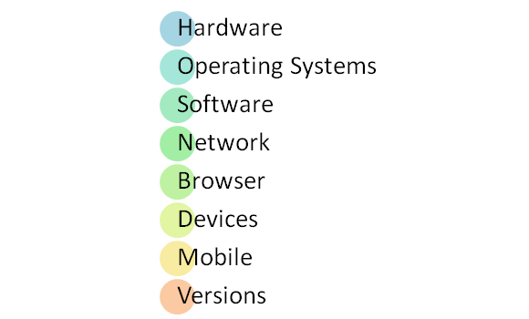
Compatibility Testing
Compatibility Testing is a type of Software testing to check whether your software is capable of running on different hardware, operating systems, applications , network environments or Mobile devices.
Compatibility Testing is a type of the Non-functional testing

Slide 43
Hardware : It checks software to be compatible with different hardware configurations .
Operating Systems: It checks your software to be compatible with different Operating Systems like Windows , Unix , Mac OS etc.
Software: It checks your developed software to be compatible with other software's. For example: MS Word application should be compatible with other software like MS Outlook, MS Excel etc.
Network: Evaluation of performance of system in a network with varying parameters such as Bandwidth, Operating speed, Capacity. It also checks application in different networks with all parameters mentioned earlier.
Browser: It checks compatibility of your website with different browsers like Firefox , Google Chrome , Internet Explorer etc.
Devices : It checks compatibility of your software with different devices like USB port Devices, Printers and Scanners, Other media devices and Blue tooth.
Mobile: Checking your software is compatible with mobile platforms like Android , iOS etc.
Versions of the software: It is verifying you software application to be compatible with different versions of software. For instance checking your Microsoft Word to be compatible with Windows 7, Windows 7 SP1 , Windows 7 SP 2 , Windows 7 SP 3.

Slide 44
Why it is required
Checking the platform (os, browser) and other application program or s/w compactable with your s/w.
What compatibility standards or guidelines should be followed that define how your s/w interact with other s/w
What type of data your s/w use to interact or share information with other s/w.

Slide 45
Types of Compatibility Testing
Forward Compatibility Testing: This type of testing verifies that the software is compatible with the newer or upcoming versions, and is thus named as forward compatible.
Backward Compatibility Testing: This type of testing helps to check whether the application designed using the latest version of an environment also works seamlessly in an older version. It is the testing performed to check the behavior of the hardware/software with the older versions of the hardware/software.

Slide 46
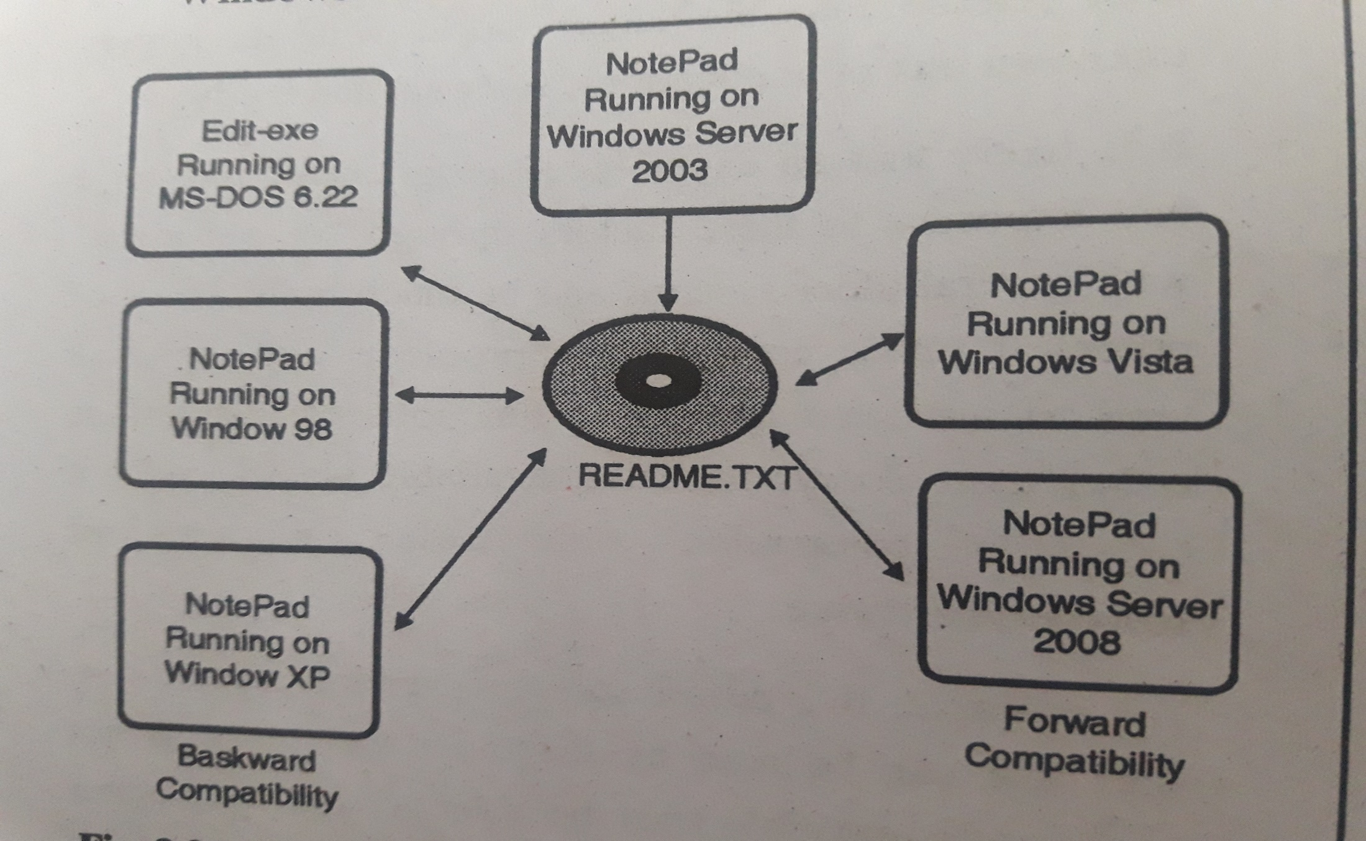

Slide 47
The Isolation of Configuration bug
Testing new s/w product with multiple versions of platform and s/w application is a huge task
compatibility testing of windows Server 2008, programmer fix numerous bug fixes and improve the performance and add many new features in the code with old features in server 2003, the goal is to be 100% compatible with them.

Slide 48
Acceptance Testing
Acceptance Testing is a level of the software testing where a system is tested for acceptability.
The purpose of this test is to evaluate the system’s compliance with the business requirements and assess whether it is acceptable for delivery.
Usually, Black Box Testing method is used in Acceptance Testing.
Acceptance Testing is performed after System Testing and before making the system available for actual use.
The acceptance test cases are executed against the test data or using an acceptance test script and then the results are compared with the expected ones.
The goal of acceptance testing is to establish confidence in the system.
Acceptance testing is most often focused on a validation type testing.

Slide 49
Acceptance Criteria
Acceptance criteria are defined on the basis of the following attributes
Functional Correctness and Completeness
Data Integrity
Data Conversion
Usability
Performance
Timeliness
Confidentiality and Availability
Installability and Upgradability
Scalability
Documentation

Slide 50
Types Of Acceptance Testing
User Acceptance test
Operational Acceptance test
Contract Acceptance testing
Compliance acceptance testing

Slide 51
User Acceptance test
It focuses mainly on the functionality thereby validating the fitness-for-use of the system by the business user. The user acceptance test is performed by the users and application managers.
Operational Acceptance test
Also known as Production acceptance test validates whether the system meets the requirements for operation. In most of the organization the operational acceptance test is performed by the system administration before the system is released. The operational acceptance test may include testing of backup/restore, disaster recovery, maintenance tasks and periodic check of security vulnerabilities.

Slide 52
Contract Acceptance testing
It is performed against the contract’s acceptance criteria for producing custom developed software. Acceptance should be formally defined when the contract is agreed.
Compliance acceptance testing
It is also known as regulation acceptance testing is performed against the regulations which must be adhered to, such as governmental, legal or safety regulations.

Slide 53
Advantages Of Acceptance Testing
The functions and features to be tested are known.
The details of the tests are known and can be measured.
The tests can be automated, which permits regression testing.
The progress of the tests can be measured and monitored.
The acceptability criteria are known.
Disadvantages Of Acceptance Testing
Requires significant resources and planning.
The tests may be a re-implementation of system tests.
It may not uncover subjective defects in the software, since you are only looking for defects you expect to find.

Slide 54
Alpha Testing
Alpha Testing is a type of testing conducted by a team of highly skilled testers at development site. Minor design changes can still be made as a result of alpha testing.
For Alpha Testing there is a dedicated test team.
Alpha testing is final testing before the software is released to the general public. It has two phases:
In the first phase of alpha testing, the software is tested by in-house developers. They use either debugger software, or hardware-assisted debuggers. The goal is to catch bugs quickly.
In the second phase of alpha testing, the software is handed over to the software QA staff, for additional testing in an environment that is similar to the intended use.

Slide 55
Pros And Cons
Pros Of Alpha Testing • Helps to uncover bugs that were not found during previous testing activities • Better view of product usage and reliability • Analyze possible risks during and after launch of the product • Helps to be prepared for future customer support • Helps to build customer faith on the product • Maintenance Cost reduction as the bugs are identified and fixed before Beta / Production launch • Easy Test Management
Cons Of Alpha Testing
• Not all the functionality of the product is expected to be tested • Only Business requirements are scoped

Slide 56
Beta Testing
Beta Testing is also known as field testing. It takes place at customer’s site. It sends the system/software to users who install it and use it under real-world working conditions.
A beta test is the second phase of software testing in which a sampling of the intended audience tries the product out
The goal of beta testing is to place your application in the hands of real users outside of your own engineering team to discover any flaws or issues from the user’s perspective that you would not want to have in your final, released version of the application.
Beta testing can be considered “pre-release testing.

Slide 57
Advantages of beta testing
You have the opportunity to get your application into the hands of users prior to releasing it to the general public.
Users can install, test your application, and send feedback to you during this beta testing period.
Your beta testers can discover issues with your application that you may have not noticed, such as confusing application flow, and even crashes.
Using the feedback you get from these users, you can fix problems before it is released to the general public.
The more issues you fix that solve real user problems, the higher the quality of your application when you release it to the general public.
Having a higher-quality application when you release to the general public will increase customer satisfaction.
These users, who are early adopters of your application, will generate excitement about your application.

Slide 58
Alpha Testing | Beta Testing
Basic Understanding
First phase of testing in Customer Validation | Second phase of testing in Customer Validation
Performed at developer's site - testing environment. Hence, the activities can be controlled | Performed in real environment, and hence activities cannot be controlled
Only functionality, usability are tested. Reliability and Security testing are not usually performed in-depth | Functionality, Usability, Reliability, Security testing are all given equal importance to be performed
White box and / or Black box testing techniques are involved | Only Black box testing techniques are involved
Build released for Alpha Testing is called Alpha Release | Build released for Beta Testing is called Beta Release
System Testing is performed before Alpha Testing | Alpha Testing is performed before Beta Testing
Issues / Bugs are logged into the identified tool directly and are fixed by developer at high priority | Issues / Bugs are collected from real users in the form of suggestions / feedbacks and are considered as improvements for future releases.
Helps to identify the different views of product usage as different business streams are involved | Helps to understand the possible success rate of the product based on real user’s feedback / suggestions.

Slide 59
Alpha Testing | Beta Testing
Test Goals
To evaluate the quality of the product | To evaluate customer satisfaction
To ensure Beta readiness | To ensure Release readiness (for Production launch)
Focus on finding bugs | Focus on collecting suggestions / feedback and evaluate them effectively
Does the product work? | Do customers like the product?
When
Usually after System testing phase or when the product is 70% - 90% complete | Usually after Alpha Testing and product is 90% - 95% complete
Features are almost freezed and no scope for major enhancements | Features are freezed and no enhancements accepted
Build should be stable for technical user | Build should be stable for real users

Slide 60
Alpha Testing | Beta Testing
Test Duration
Many test cycles conducted | Only 1 or 2 test cycles conducted
Each test cycle lasts for 1 - 2 weeks | Each test cycle lasts for 4 - 6 weeks
Duration also depends on the number of issues found and number of new features added | Test cycles may increase based on real user's feedback / suggestion
Stake Holders
Engineers (in-house developers), Quality Assurance Team, and Product Management Team | Product Management, Quality Management, and User Experience teams
Participants
Technical Experts, Specialized Testers with good domain knowledge (new or who were already part of System Testing phase), Subject Matter Expertise | End users to whom the product is designed
Customers and / or End Users can participate in Alpha Testing in some cases | Customers also usually participate in Beta Testing

Slide 61
Alpha Testing | Beta Testing
Expectations
Acceptable number of bugs that were missed in earlier testing activities | Major completed product with very less amount of bugs and crashes
Incomplete features and documentation | Almost completed features and documentation
Entry Criteria
• Alpha Tests designed and reviewed for Business requirements • Traceability matrix should be achieved for all the between alpha tests and requirements • Testing team with knowledge about the domain and product • Environment setup and build for execution • Tool set up should be ready for bug logging and test management System testing should be signed-off (ideally) | • Beta Tests like what to test and procedures documented for Product usage • No need of Traceability matrix • Identified end users and customer team up • End user environment setup • Tool set up should be ready to capture the feedback / suggestions • Alpha Testing should be signed off
Exit Criteria
• All the alpha tests should be executed and all the cycles should be completed • Critical / Major issues should be fixed and retested • Effective review of feedback provided by participants should be completed • Alpha Test Summary report • Alpha testing should be signed off | • All the cycles should be completed • Critical / Major issues should be fixed and retested • Effective review of feedback provided by participants should be completed • Beta Test summary report • Beta Testing should be signed off

Slide 62
Alpha Testing | Beta Testing
Pros
• Helps to uncover bugs that were not found during previous testing activities • Better view of product usage and reliability • Analyze possible risks during and after launch of the product • Helps to be prepared for future customer support • Helps to build customer faith on the product • Maintenance Cost reduction as the bugs are identified and fixed before Beta / Production launch • Easy Test Management | • Product testing is not controllable and user may test any available feature in any way - corner areas are well tested in this case • Helps to uncover bugs that were not found during previous testing activities (including alpha) • Better view of product usage, reliability, and security • Analyze the real user's perspective and opinion on the product • Feedback / suggestions from real users helps in improvising the product in future • Helps to increase customer satisfaction on the product
Cons
• Not all the functionality of the product is expected to be tested • Only Business requirements are scoped | • Scope defined may or may not be followed by participants • Documentation is more and time consuming - required for using bug logging tool (if required), using tool to collect feedback / suggestion, test procedure (installation / uninstallation, user guides) • Not all the participants assure to give quality testing • Not all the feedback are effective - time taken to review feedback is high • Test Management is too difficult

Slide 63
Smoke Testing
Smoke testing is the surface level testing to certify that build provided by development to QA is ready to accept for further testing.
In smoke testing we only checks the major functionality of the software.
Smoke testing is also known by the name BAT (Build Acceptance Test) because it establishes the acceptance criteria for QA to accept and reject a build for further testing. So apart from smoke testing it is also very important for software people to know about build.
A build is called as the version of software, typically one that is still in testing stage.
Smoke testing is performed by developers before releasing the build to the testing team and after releasing the build to the testing team it is performed by testers whether to accept the build for further testing or not.
If the build clears the Smoke test, then it is accepted by QA for further testing, however if the build fails the Smoke test, then it’s rejected and QA reverts back to previously accepted build.

Slide 64
Smoke Testing Example
In a project there are five modules like
login,
view user,
user detail page,
new user creation and
task creation etc.
In these five modules, the developer will first perform the smoke testing by executing all the major functionality of modules like user is able to login with valid login credentials or not, after login new user can be created or not, user that is created is viewed or not etc. It makes it obvious that the smoke test is always done by developing team before submitting the build to the testing team.

Slide 65
Advantages of Smoke testing:
It helps to find issues introduced in integration of modules.
It helps to find issues in the early phase of testing.
It helps to get confidence to tester that fixes in the previous builds not breaking major features (only features exercised by smoke testing).
Facts about smoke testing:
A smoke test is a subset of the test cases that is typically representative of the overall test plan.
Smoke tests are good for verifying proper deployment or other non invasive changes.
They are also useful for verifying a build is ready to send to test.
Smoke tests are not substitute for actual functional testing.

Slide 66
Sanity Testing
Sanity Testing is the subset of Regression Testing and it is performed when we do not have enough time for doing testing.
Sanity testing is the surface level testing where QA engineer verifies that all the menus, functions, commands available in the product and project are working fine.
Sanity testing is performed after the build has clear the Smoke test and has been accepted by QA team for further testing, sanity testing checks the major functionality with finer details.
Sanity testing is performed when development team needs to know quick state of the product after they have done changes in the code or there is some controlled code change in a feature to fix any critical issue, and stringent release time-frame does not allow complete regression testing.
Sanity testing will be done mostly after retest (retest will be done after fixing the bug). We always use Script for Smoke but do not for sanity.

Slide 67
Sanity Testing Example
For Example in a project there are five modules like login page, home page, user detail page, new user creation, and task creation etc. So we have the bug in login page like on login page username field accepts the less than six alpha-numeric characters which are against the requirements as in requirements it is specified that username should not be below than six characters but as username accepts the less than six characters it is the bug.
So now the bug is reported by the testing team to the developer team to fix it. When the developing team fixes the bug and passed it to testing team than the testing team checks the other modules of the application means checks that fix bug does not affect the functionality of the other modules but keep one point always in mind that testing team only checks the extreme functionality of the modules, do not go deep to test the details because of the short time so this is the sanity testing.

Slide 68
Smoke Testing | Sanity Testing
Smoke Testing is performed to ascertain that the critical functionalities of the program is working fine | Sanity Testing is done to check the new functionality / bugs have been fixed
The objective of this testing is to verify the "stability" of the system in order to proceed with more rigorous testing | The objective of the testing is to verify the "rationality" of the system in order to proceed with more rigorous testing
This testing is performed by the developers or testers | Sanity testing is usually performed by testers
Smoke testing is usually documented or scripted | Sanity testing is usually not documented and is unscripted
Smoke testing is a subset of Regression Testing | Sanity testing is a subset of Acceptance testing
Smoke testing exercises the entire system from end to end | Sanity testing exercises only the particular component of the entire system
Smoke testing is like General Health Check Up | Sanity Testing is like specialized health check up

Slide 69
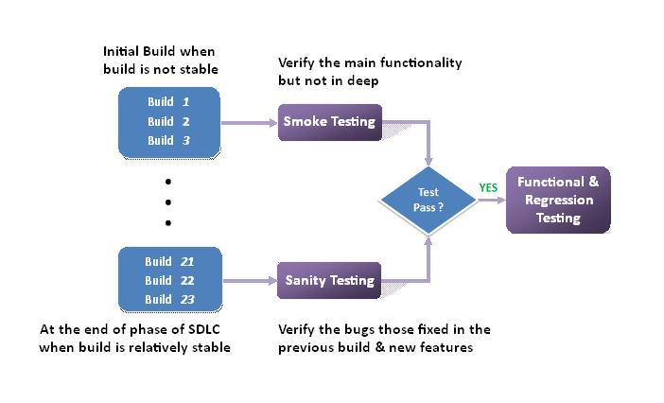

Slide 70
Regression Testing
Regression Testing is defined as a type of software testing to confirm that a recent program or code change has not adversely affected existing features.
Regression Testing is nothing but full or partial selection of already executed test cases which are re-executed to ensure existing functionalities work fine.
This testing is done to make sure that new code changes should not have side effects on the existing functionalities. It ensures that old code still works once the new code changes are done.
Regression Testing is required when there is a
Change in requirements and code is modified according to the requirement
New feature is added to the software
Defect fixing
Performance issue fix

Slide 71
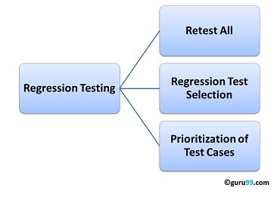
Regression Testing Techniques :

Slide 72
Retest All
This is one of the methods for Regression Testing in which all the tests in the existing test bucket or suite should be re-executed. This is very expensive as it requires huge time and resources.
Regression Test Selection
Instead of re-executing the entire test suite, it is better to select part of test suite to be run
Test cases selected can be categorized as 1) Reusable Test Cases 2) Obsolete Test Cases.
Re-usable Test cases can be used in succeeding regression cycles.
Obsolete Test Cases can't be used in succeeding cycles.
Prioritization of Test Cases
Prioritize the test cases depending on business impact, critical & frequently used functionalities. Selection of test cases based on priority will greatly reduce the regression test suite.

Slide 73
Selecting test cases for regression testing
It was found from industry data that good number of the defects reported by customers were due to last minute bug fixes creating side effects and hence selecting the Test Case for regression testing is an art and not that easy.
Effective Regression Tests can be done by selecting following test cases –
Test cases which have frequent defects
Functionalities which are more visible to the users
Test cases which verify core features of the product
Test cases of Functionalities which has undergone more and recent changes
All Integration Test Cases
All Complex Test Cases
Boundary value test cases
Sample of Successful test cases
Sample of Failure test cases

Slide 74
Regression Testing Tools
If your software undergoes frequent changes, regression testing costs will escalate.
In such cases, Manual execution of test cases increases test execution time as well as costs.
Following are most important tools used for both functional and regression testing:
Selenium: This is an open source tool used for automating web applications. Selenium can be used for browser based regression testing.
Quick Test Professional (QTP): HP Quick Test Professional is automated software designed to automate functional and regression test cases. It uses VBScript language for automation. It is a Data driven, Keyword based tool.
Rational Functional Tester (RFT): IBM's rational functional tester is a Java tool used to automate the test cases of software applications. This is primarily used for automating regression test cases and it also integrates with Rational Test Manager.

Slide 75
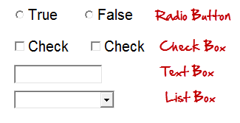
GUI Testing
There are two types of interfaces for a computer application.
Command Line Interface is where you type text and computer responds to that command.
GUI stands for Graphical User Interface where you interact with the computer using images rather than text.
GUI testing is the process of testing the system's Graphical User Interface of the Application Under Test. GUI testing involves checking the screens with the controls like menus, buttons, icons, and all types of bars - toolbar, menu bar, dialog boxes and windows, etc.
GUI is what user sees. A user does not see the source code. The interface is visible to the user. Especially the focus is on the design structure, images that they are working properly or not.
Following are the GUI elements which can be used for interaction between the user and application:

Slide 76
In addition to functionality, GUI testing evaluates design elements such as layout, colors, fonts, font sizes, labels, text boxes, text formatting, captions, buttons, lists, icons, links and content. GUI testing processes can be either manual or automatic, and are often performed by third -party companies, rather than developers or end users.

Slide 77
Object Oriented Application Testing
The process of testing object-oriented systems begins with a review of the object-oriented analysis and design models. Once the code is written object-oriented testing (OOT) begins by testing "in the small" with class testing (class operations and collaborations). As classes are integrated to become subsystems class collaboration problems are investigated. Finally, use-cases from the OOA model are used to uncover software validation errors.
Test cases are developed to exercise the classes, their collaborations, and behavior.
OOT tends to focus more on integration problems than on unit testing.

Slide 78
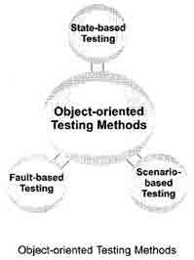
Unit testing in the OO context
Smallest testable unit is the encapsulated class or object
Similar to system testing of conventional software
Do not test operations in isolation from one another
Driven by class operations and state behavior, not algorithmic detail and data flow across module interface
Complete test coverage of a class involves
Testing all operations associated with an object
Setting and interrogating all object attributes
Exercising the object in all possible states

Slide 79
State-based testing
State-based testing is used to verify whether the methods (a procedure that is executed by an object) of a class are interacting properly with each other. This testing seeks to exercise the transitions among the states of objects based upon the identified inputs.
For this testing, finite-state machine (FSM) or state-transition diagram representing the possible states of the object and how state transition occurs is built. In addition, state-based testing generates test cases, which check whether the method is able to change the state of object as expected. If any method of the class does not change the object state as expected, the method is said to contain errors.
To perform state-based testing, a number of steps are followed, which are listed below.
Derive a new class from an existing class with some additional features, which are used to examine and set the state of the object.
Next, the test driver is written. This test driver contains a main program to create an object, send messages to set the state of the object, send messages to invoke methods of the class that is being tested and send messages to check the final state of the object.
Finally, stubs are written. These stubs call the untested methods.

Slide 80
Fault-based Testing
Fault-based testing is used to determine or uncover a set of plausible faults or the focus of tester in this testing is to detect the presence of possible faults.
Fault-based testing starts by examining the analysis and design models of OO software as these models may provide an idea of problems in the implementation of software.
With the knowledge of system under test and experience in the application domain, tester designs test cases where each test case targets to uncover some particular faults.
The effectiveness of this testing depends highly on tester experience in application domain and the system under test.
This is because if he fails to perceive real faults in the system to be plausible, testing may leave many faults undetected.

Slide 81
However, examining analysis and design models may enable tester to detect large number of errors with less effort.
As testing only proves the existence and not the absence of errors, this testing approach is considered to be an effective method and hence is often used when security or safety of a system is to be tested.
Integration testing applied for OO software targets to uncover the possible faults in both operation calls and various types of messages (like a message sent to invoke an object).
These faults may be unexpected outputs, incorrect messages or operations, and incorrect invocation.
The faults can be recognized by determining the behavior of all operations performed to invoke the methods of a class.

Slide 82
Scenario-based Testing
Scenario-based testing is used to detect errors that are caused due to incorrect specifications and improper interactions among various segments of the software.
Incorrect interactions often lead to incorrect outputs that can cause malfunctioning of some segments of the software.
The use of scenarios in testing is a common way of describing how a user might accomplish a task or achieve a goal within a specific context or environment.
Note that these scenarios are more context- and user specific instead of being product-specific. Generally, the structure of a scenario includes the following points.
A condition under which the scenario runs.
A goal to achieve, which can also be a name of the scenario.
A set of steps of actions.
An end condition at which the goal is achieved.
A possible set of extensions written as scenario fragments.

Slide 83
Scenario- based testing combines all the classes that support a use-case (scenarios are subset of use-cases) and executes a test case to test them. Execution of all the test cases ensures that all methods in all the classes are executed at least once during testing.
However, testing all the objects (present in the classes combined together) collectively is difficult. Thus, rather than testing all objects collectively, they are tested using either top-down or bottom-up integration approach.
This testing is considered to be the most effective method as scenarios can be organized in such a manner that the most likely scenarios are tested first with unusual or exceptional scenarios considered later in the testing process.
This satisfies a fundamental principle of testing that most testing effort should be devoted to those paths of the system that are mostly used.

Slide 84
Types of UML Diagrams
The current UML standards call for 13 different types of diagrams: class, activity, object, use case, sequence, package, state, component, communication, composite structure, interaction overview, timing, and deployment.
These diagrams are organized into two distinct groups: structural diagrams and behavioral or interaction diagrams.
Structural UML diagrams
Class diagram
Package diagram
Object diagram
Component diagram
Composite structure diagram
Deployment diagram
Behavioral UML diagrams
Activity diagram
Sequence diagram
Use case diagram
State diagram
Communication diagram
Interaction overview diagram
Timing diagram

Slide 85
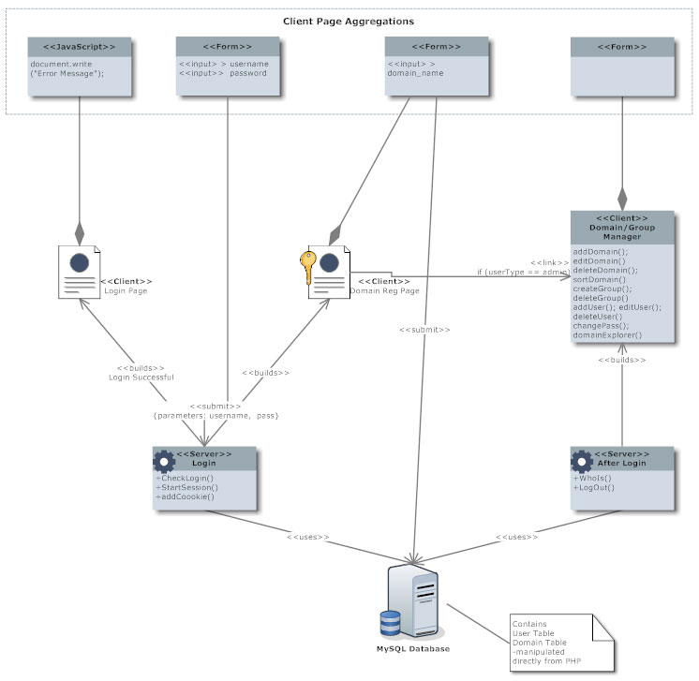
Class Diagram Class diagrams are the backbone of almost every object-oriented method, including UML. They describe the static structure of a system

Slide 86
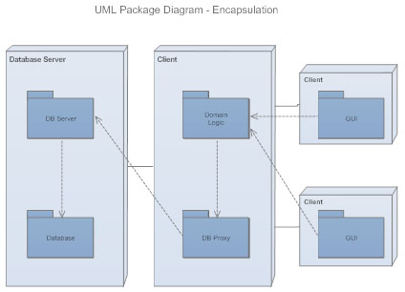
Package Diagram Package diagrams are a subset of class diagrams, but developers sometimes treat them as a separate technique. Package diagrams organize elements of a system into related groups to minimize dependencies between packages.

Slide 87
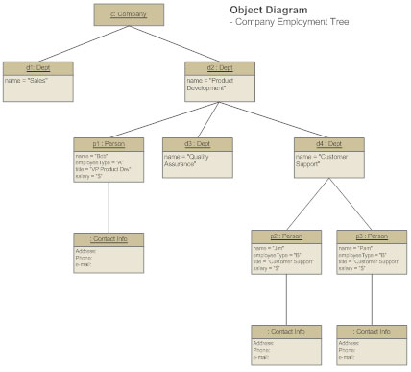
Object Diagram Object diagrams describe the static structure of a system at a particular time. They can be used to test class diagrams for accuracy.

Slide 88
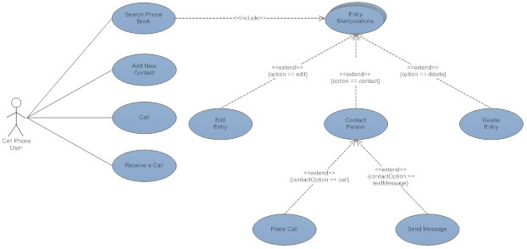
Use Case Diagram Use case diagrams model the functionality of a system using actors and use cases

Slide 89
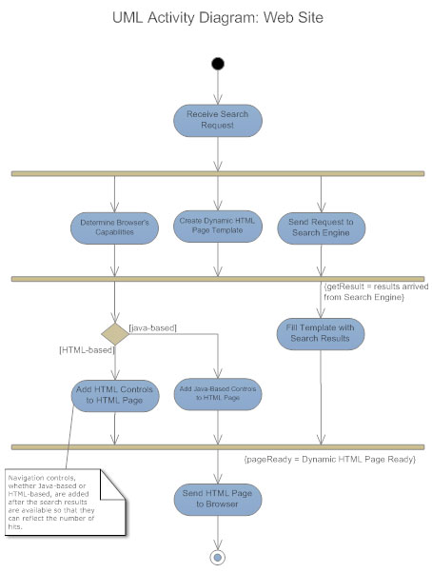
Activity Diagram Activity diagrams illustrate the dynamic nature of a system by modeling the flow of control from activity to activity. An activity represents an operation on some class in the system that results in a change in the state of the system. Typically, activity diagrams are used to model workflow or business processes and internal operation.

Slide 90
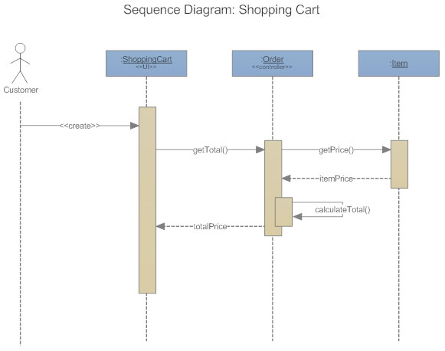
Sequence Diagram Sequence diagrams describe interactions among classes in terms of an exchange of messages over time

Slide 91
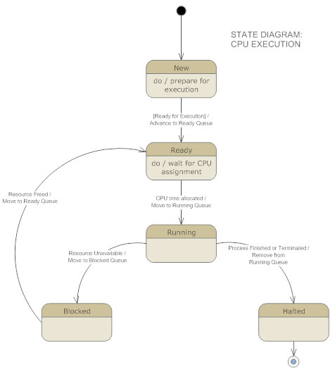
State Diagram Statechart diagrams, now known as state machine diagrams and state diagrams describe the dynamic behavior of a system in response to external stimuli. State diagrams are especially useful in modeling reactive objects whose states are triggered by specific events

Slide 92
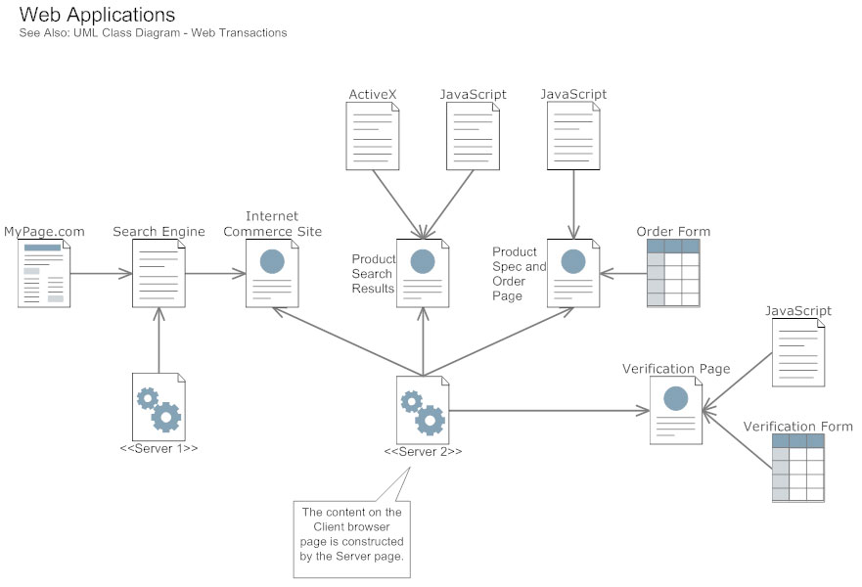
Component Diagram Component diagrams describe the organization of physical software components, including source code, run-time (binary) code, and executables.

Slide 93
Interaction Overview Diagram
Interaction overview diagrams are a combination of activity and sequence diagrams. They model a sequence of actions and let you deconstruct more complex interactions into manageable occurrences. You should use the same notation on interaction overview diagrams that you would see on an activity diagram.
Timing Diagram
A timing diagram is a type of behavioral or interaction UML diagram that focuses on processes that take place during a specific period of time. They're a special instance of a sequence diagram, except time is shown to increase from left to right instead of top down.
Communication Diagram
Communication diagrams model the interactions between objects in sequence. They describe both the static structure and the dynamic behavior of a system. In many ways, a communication diagram is a simplified version of a collaboration diagram introduced in UML 2.0.

