Slide 1
Adapter Class
Java AWT Adapters are abstract classes from java.awt.event package.
Every listener that includes more than one abstract method has got a corresponding adapter class.
The adapter classes are very special classes that are used to make event handling very easy.
There are listener interfaces that have many methods for event handling and we know that by implementing an interface we have to implement all the methods of that interface.
But sometimes we need only one or some methods of the interface.
In that case, Adapter classes are the best solution.

Slide 2
For example, the MouseListener interface has five methods: mouseClicked(), mouseEntered(), mouseExited(), mousePressed() and mouseReleased().
If in your program, you just need two events: mouseEntered() and mouseExited() that time you can use adapter class for the mouseListener interface.
The adpter classes contain an empty implementation for each method of the event listener interface.
To use the adapter class, you have to extend that adapter class.

Slide 3
Listener Interface | Adapter Class
ComponentListener | ComponentAdapter
ContainerListener | ContainerAdapter
FocusListener | FocusAdapter
KeyListener | KeyAdapter
MouseListener | MouseAdapter
MouseMotionListener | MouseMotionAdapter
WindowListener | WindowAdapter

Slide 4
Here's a mouse adapter that beeps when the mouse is clicked
import java.awt.*;
import java.awt.event.*;
public class MouseBeeper extends MouseAdapter
{
public void mouseClicked(MouseEvent evt)
{
Toolkit.getDefaultToolkit().beep();
}
}
Without extending the MouseAdapter class, I would have had to write the same class like this
import java.awt.*;
import java.awt.event.*;
public class MouseBeeper implements MouseListener
{
public void mouseClicked(MouseEvent evt)
{
Toolkit.getDefaultToolkit().beep();
}
public void mousePressed(MouseEvent evt) {}
public void mouseReleased(MouseEvent evt) {}
public void mouseEntered(MouseEvent evt) {}
public void mouseExited(MouseEvent evt) {}
}

Slide 5
Inner Classes
Inner classes are a security mechanism in Java.
Inner class is a class defined inside other class and act like a member of the enclosing class.
Unlike a class, an inner class can be private and once you declare an inner class private, it cannot be accessed from an object outside the class.

Slide 6
class Outer_Demo
{
int num;
//inner class
private class Inner_Demo
{
public void print()
{
System.out.println("This is an inner class");
}
}
//Accessing the inner class from the method within the outer class
void display_Inner()
{
Inner_Demo inner = new Inner_Demo();
inner.print();
}
}

Slide 7
public class My_class
{
public static void main(String args[])
{
//Instantiating the outer class
Outer_Demo outer=new Outer_Demo();
//Accessing the display_Inner() method.
outer.display_Inner();
}
}

Slide 8
Inner classes are of three types depending on how and where you define them. They are:
Inner Class
Method-local Inner Classes
Anonymous Inner Class

Slide 9
Method-local Inner Class
When an inner class is defined inside the method of Outer Class it becomes Method local inner class.
Method local inner class can be instantiated within the method where it is defined and no where else.
Method local inner class can only be declared as final or abstract.
Method local class can only access global variables or method local variables if declared as final.

Slide 10
public class Outerclass
{
//instance method of the outer class
void my_Method()
{
int num=23;
//method-local inner class
class MethodInner_Demo
{
public void print()
{
System.out.println("This is method inner class "+num);
}
}//end of inner class
//Accessing the inner class
MethodInner_Demo inner=new MethodInner_Demo();
inner.print();
}
public static void main(String args[])
{
Outerclass outer =new Outerclass();
outer.my_Method();
}
}

Slide 11
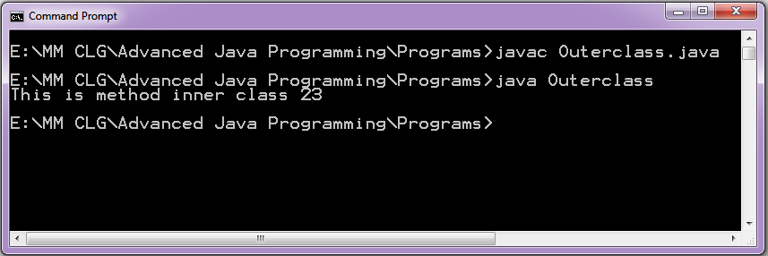
Output will be:

Slide 12
Advantage of java inner classes
Nested classes represent a special type of relationship that is it can access all the members (data members and methods) of outer class including private and still have its own type.
The outer class members which are going to be used by the inner class can be made private and the inner class members can be hidden from the classes in the same package. This increases the level of encapsulation.
Nested classes are used to develop more readable and maintainable code because it logically group classes and interfaces in one place only.
Code Optimization: It requires less code to write.

