Slide 1
Introduction to Swing
Swing API is set of extensible GUI Components to create JAVA based Front End/ GUI Applications. It is build upon top of AWT API and acts as replacement of AWT API as it has almost every control corresponding to AWT controls.

Slide 2
Swing Features
Light Weight - Swing component are independent of native Operating System's API as Swing API controls are rendered mostly using pure JAVA code instead of underlying operating system calls.
Rich controls - Swing provides a rich set of advanced controls like Tree, TabbedPane, slider, colorpicker, table controls
Pluggable look-and-feel- SWING based GUI Application look and feel can be changed at run time based on available values.

Slide 3
Difference between AWT and Swing
No. | Java AWT | Java Swing
1 | AWT components are platform-dependent. | Java swing components are platform-independent.
2 | AWT components are heavyweight. | Swing components are lightweight.
3 | AWT doesn't support pluggable look and feel. | Swing supports pluggable look and feel.
4 | AWT provides less components than Swing. | Swing provides more powerful componentssuch as tables, lists, scrollpanes, colorchooser, tabbedpane etc.
5 | AWT doesn't follows MVC(Model View Controller) where model represents data, view represents presentation and controller acts as an interface between model and view. | Swing follows MVC.

Slide 4
MVC Architecture
Swing API architecture follows MVC architecture. The MVC design pattern consists of three modules: model, view and controller.
Model -The model represents the state (data) and business logic of the application.
View -The view module is responsible to display data i.e. it represents the presentation.
Controller -The controller module acts as an interface between view and model. It intercepts all the requests i.e. receives input and commands to Model / View to change accordingly.

Slide 5
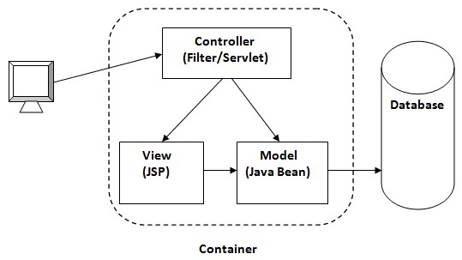
Figure: MVC Architecture

Slide 6
JComboBox
Combo box is a combination of text fields and drop-down list.JComboBox component is used to create a combo box in Swing.
Constructor for JComboBox
JComboBox()
JComboBox(String arr[])

Slide 7
Methods used with JComboBox
void addItem(Object anObject)
Adds an item to the item list.
void addItemListener(ItemListener aListener)
Adds an ItemListener.
Object getItemAt(int index)
Returns the list item at the specified index.
int getItemCount()
Returns the number of items in the list.
Object getSelectedItem()
Returns the current selected item.
void removeAllItems()
Removes all items from the item list.
void removeItem(Object anObject)
Removes an item from the item list.
void removeItemAt(int anIndex)
Removes the item at anIndex This method works only if the JComboBox uses a mutable data model.

Slide 8
import javax.swing.*;
public class JComboTest
{
JFrame f;
JComboTest()
{
f=new JFrame("Combo ex");
String country[]={"India","Aus","U.S.A","England","Newzeland"};
JComboBox cb=new JComboBox(country);
cb.setBounds(50, 50,90,20);
f.add(cb);
f.setLayout(null);
f.setSize(400,500);
f.setVisible(true);
f.setDefaultCloseOperation(JFrame.EXIT_ON_CLOSE);
}
public static void main(String[] args)
{
new JComboTest();
}
}

Slide 9
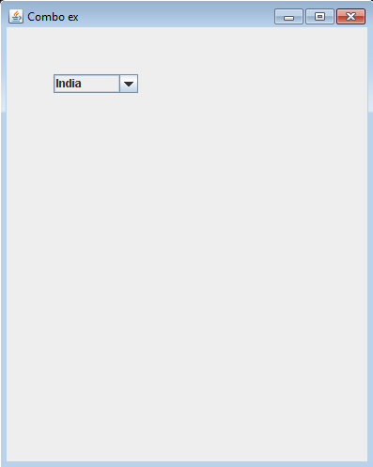
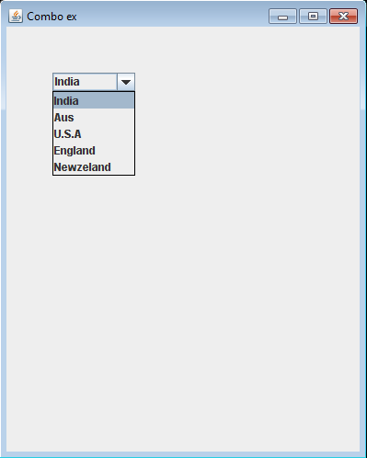

Slide 10
JProgressBar
The class JProgressBar is a component which visually displays the progress of some task.

Slide 11
Constructors of JProgessBar
JProgressBar()
Creates a horizontal progress bar that displays a border but no progress string.
JProgressBar(int orient)
Creates a progress bar with the specified orientation, which can be either SwingConstants. VERTICAL or SwingConstants.HORIZONTAL.
JProgressBar(int min, int max)
Creates a horizontal progress bar with the specified minimum and maximum values.
JProgressBar(int orient, int min, int max)
Creates a progress bar using the specified orientation, minimum and maximum values.

Slide 12
Methods used with JProgressBar
void setStringPainted(boolean b)
determines whether the progress bar should display a progress string.
int getMaximum()
Returns the progress bar's maximum value
int getMinimum()
Returns the progress bar's minimum value from the BoundedRangeModel.
int getOrientation()
Returns SwingConstants.VERTICAL or SwingConstants.HORIZONTAL, depending on the orientation of the progress bar.

Slide 13
import javax.swing.*;
public class MyProgress extends Jframe
{
JProgressBar jb;
int i=0,num=0;
MyProgress()
{
jb=new JProgressBar(0,2000);
jb.setBounds(40,40,200,30);
jb.setValue(0);
jb.setStringPainted(true);
add(jb);
setSize(400,400);
setLayout(null);
}
setDefaultCloseOperation(JFrame.EXIT_ON_CLOSE);
public void iterate()
{
while(i<=2000)
{
jb.setValue(i);
i=i+20;
try
{
Thread.sleep(150);
}
catch(Exception e){}
}
}
public static void main(String[] args)
{
MyProgress m=new MyProgress();
m.setVisible(true);
m.iterate();
}
}

Slide 14
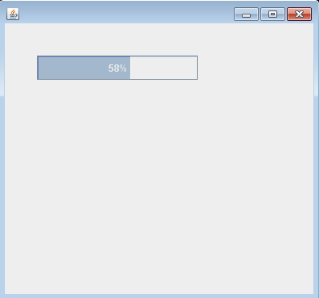
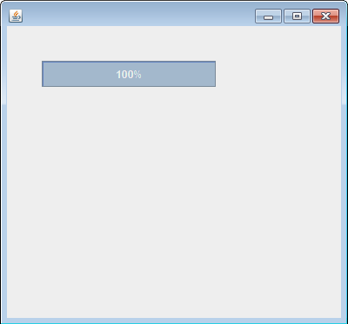

Slide 15
JPanel
A panel is a swing container which is used for grouping components which is later on added to the frame. In java swing panel is implemented by JPanel class.

Slide 16
Constructors of JPanel
JPanel()
Creates a panel.
JPanel(LayoutManager)
The LayoutManager parameter provides a layout manager for the new panel. By default, a panel uses a FlowLayout to lay out its components.

Slide 17
import javax.swing.*; import java.io.*; class B { public static void main(String arg[]) { JFrame f=new JFrame("this is my new frame"); JPanel p=new JPanel(); f.add(p); f.setSize(200,200); f.setVisible(true); f.setDefaultCloseOperation(JFrame.EXIT_ON_CLOSE); } }

Slide 19
JScrollPane
A JScrollPane provides a scrollable view of a component. When screen real estate is limited, use a scroll pane to display a component that is large or one whose size can change dynamically. i.e. It represents a scrollpane which is a rectangular area in which a component may be viewed.

Slide 20
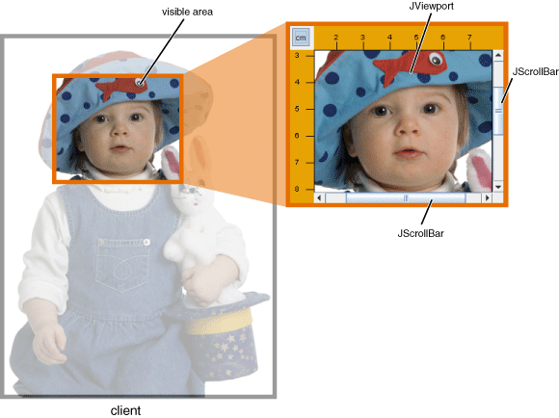

Slide 21
Constructors of JScrollPane
JScrollPane()
Create a scroll pane
JScrollPane(Component com)
com is component which is added to scroll pane.
JScrollPane(int vsb, int hsb)
vasb and hsb are int constants for controlling vertical and horizontal scrolling.
JScrollPane(Component com, int vsb, int hsb)

Slide 22
int constants vsb nad hsb can have the values:
VERTICAL_SCROLLBAR_ALWAYS
Vertical scroll bar is always provided.
HORIZONTAL_SCROLLBAR_ALWAYS
Horizontal scroll bar is always provided.
VERTICAL_SCROLLBAR_AS_NEEDED
Vertical scroll bar is provided as per the need.
HORIZONTAL_SCROLLBAR_AS_NEEDED
Horizontal scroll bar is provided as per the need.

Slide 23
import javax.swing.*; import java.awt.event.*; public class scroll { public static void main(String[] args) { String s="Welcome to Java Swing programming!!!!! This shows the working of JScrollPane....."; JTextArea t=new JTextArea(s,10,10); JFrame f=new JFrame("Frame"); f.setDefaultCloseOperation(JFrame.EXIT_ON_CLOSE); JPanel p=new JPanel(); int v=ScrollPaneConstants.VERTICAL_SCROLLBAR_ALWAYS; int h=ScrollPaneConstants.HORIZONTAL_SCROLLBAR_AS_NEEDED; JScrollPane sp=new JScrollPane(t,v,h); p.add(sp); f.add(p); f.setSize(200,200); f.setVisible(true); } }

Slide 24
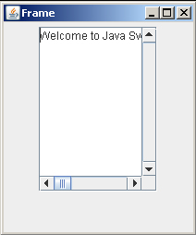

Slide 25
JTable
The JTable class is used to display the data on two dimensional tables of cells.
Constructors of JTable class:
JTable()
creates a table with empty cells.
JTable(Object[][] rows, Object[] columns)
creates a table with the specified data.

Slide 26
import javax.swing.*;
public class MyJTable extends JFrame {
MyJTable()
{
String data[][]={
{"101","Umesh","670000"},
{"102","Vijay","780000"},
{"101","Rahul","700000"}};
String column[]={"ID","NAME","SALARY"};
JTable jt=new JTable(data,column);
jt.setBounds(30,40,200,300);
JScrollPane sp=new JScrollPane(jt);
add(sp);
setSize(300,400);
setVisible(true);
setDefaultCloseOperation(JFrame.EXIT_ON_CLOSE);
}
public static void main(String[] args) {
new MyJTable();
}
}

Slide 27
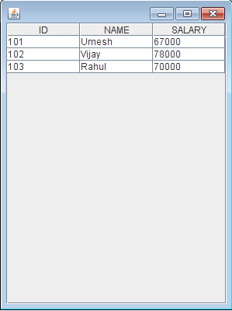

Slide 28
JTabbedPane
JTabbedPane is a container component that lets the user switch between pages by clicking on a tab.

Slide 29
Constructors for JTabbedPane
JTabbedPane() Creates an empty TabbedPane with a default tab placement of JTabbedPane.TOP.
JTabbedPane(int tabPlacement) Creates an empty TabbedPane with the specified tab placement of either: JTabbedPane.TOP, JTabbedPane.BOTTOM, JTabbedPane.LEFT, or JTabbedPane.RIGHT.
JTabbedPane(int tabPlacement, int tabLayoutPolicy) Creates an empty TabbedPane with the specified tab placement and tab layout policy.

Slide 30
import javax.swing.*;
/* <applet code="exp43" width=400 height=100> </applet> */
public class exp43 extends JApplet
{
public void init()
{
JTabbedPane exp43 = new JTabbedPane();
exp43.addTab("Cities", new CitiesPanel());
exp43.addTab("Colors", new ColorsPanel());
exp43.addTab("Flavors", new FlavorsPanel());
add(exp43);
}
}

Slide 31
class CitiesPanel extends JPanel
{
public CitiesPanel()
{
JButton b1 = new JButton("Kolhapur");
add(b1);
JButton b2 = new JButton("Karad");
add(b2);
JButton b3 = new JButton("Satara");
add(b3);
JButton b4 = new JButton("Pune");
add(b4);
}
}

Slide 32
class ColorsPanel extends JPanel
{
public ColorsPanel()
{
JCheckBox cb1 = new JCheckBox("Red");
add(cb1);
JCheckBox cb2 = new JCheckBox("Green");
add(cb2);
JCheckBox cb3 = new JCheckBox("Blue");
add(cb3);
}
}
class FlavorsPanel extends JPanel
{
public FlavorsPanel()
{
JComboBox jcb = new JComboBox();
jcb.addItem("Vanilla");
jcb.addItem("Chocolate");
jcb.addItem("Strawberry");
add(jcb);
}
}

Slide 33
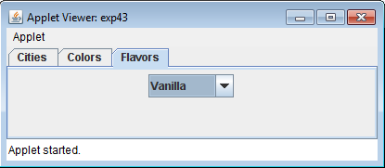

Slide 34
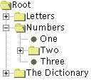
JTree
JTree class is a powerful Swing component for displaying tree-structured data.
A JTree object does not actually contain your data; it simply provides a view of the data. Like any non-trivial Swing component, the tree gets data by querying its data model. Here is a picture of a tree:

Slide 35
Each row displayed by the tree contains exactly one item of data, which is called a node.
Every tree has a root node from which all nodes descend.
A node can either have children or not.
We refer to nodes that can have children as branch nodes. Nodes that can not have children are leaf nodes.
Branch nodes can have any number of children.

Slide 36
A specific node in a tree can be identified either by a TreePath, an object that encapsulates information about the node, or by its display row, where each row in the display area displays one node.
An expanded node is a non-leaf node that will display its children when all its ancestors are expanded.
A collapsed node is one which hides them.
A hidden node is one which is under a collapsed ancestor.

Slide 37
Constructors Of JTree
JTree(Hashtable ht)
Returns a JTree created from a Hashtable which does not display with root. Each element of hashtable is a childnode.
JTree(Object[] value)
Returns a JTree with each element of the specified array as the child of a new root node which is not displayed. Each element of the array object is childnode.
JTree(TreeNode root)
Returns a JTree with the specified TreeNode as its root, which displays the root node. Treenode tn is the root of the tree.
JTree(Vector v)
Returns a JTree with each element of the specified Vector as the child of a new root node which is not displayed. Elements of vector v is the childnode

Slide 38
It is possible to obtain a reference to the parent node.
The ‘MutableTreeNode’ interface extends ‘TreeNode’, which is an interface that declares methods that obtain information about a tree node.
The ‘DefaultMutableTreeNode’ class implements the ‘MutableTreeNode’ interface. It represents a node in a tree.

Slide 39
Methods used with JTree
DefaultMutableTreeNode(object obj)
where ‘obj’ is the object to be enclosed in this tree node.
void add(MutableTreeNode child)
This method can be used to create the hierarchy of nodes .where ‘child’ is the mutable treenode this is to be added as a child to the current node.
TreePath getPathForLocation(int x, int y)
It is used to translate a mouse click on a point of tree to a tree path. Where, x and y are coordinates of mouse click.

Slide 40
import java.awt.*; import javax.swing.*; import javax.swing.tree.*; public class tree { public static void main(String[] args) { wood o=new wood(); o.wod(); } }

Slide 41
class wood extends JFrame { public void wod() { JFrame f=new JFrame(); DefaultMutableTreeNode root=new DefaultMutableTreeNode("Asia"); DefaultMutableTreeNode country=new DefaultMutableTreeNode("India"); DefaultMutableTreeNode state=new DefaultMutableTreeNode("Madhya Pradesh"); DefaultMutableTreeNode city=new DefaultMutableTreeNode("Gwalior"); root.add(country); country.add(state); state.add(city); JTree tree=new JTree(root); f.add(tree); f.setDefaultCloseOperation(JFrame.EXIT_ON_CLOSE); f.setSize(300,300); f.setVisible(true); } }

Slide 42
import javax.swing.JButton;
import javax.swing.JFrame;
public class JButtonWithTooltip extends Jframe
{
public JButtonWithTooltip()
{
setDefaultCloseOperation(JFrame.EXIT_ON_CLOSE);
JButton b = new JButton("Test");
b.setToolTipText("Help text for the button"); getContentPane().add(b, "Center");
pack();
}
public static void main(String[] args)
{
new JButtonWithTooltip().setVisible(true);
}
}

Slide 43
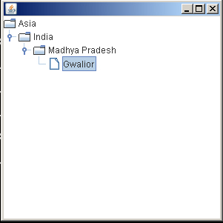

Slide 44
ToolTip
Tooltip text is normally one line long. The setToolTipText() method from JComponent used to create a tooltip.
public void setToolTipText(String text)
-Registers the text to display in a tool tip. The text displays when the cursor lingers over the component.

Slide 45
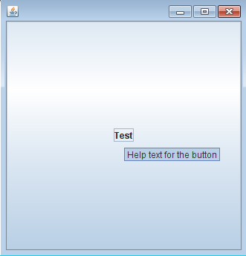

Slide 46
JSeparators
The JSeparator class provides a horizontal or vertical dividing line or empty space. It's most commonly used in menus and tool bars.
Separators are similar to borders, except that they are genuine components and are drawn inside a container, rather than around the edges of a particular component.
Menus and tool bars provide convenience methods that create and add separators customized for their containers.
menu.addSeparator();

Slide 47
Consrtuctors for JSeparators
JSeparator()
Create a separator. If you don't specify an argument, the separator is horizontal.
JSeparator(int)
The argument can be either SwingConstants.HORIZONTAL or SwingConstants.VERTICAL.

Slide 48
import javax.swing.*;
public class MenuSeparator extends Jframe
{
public MenuSeparator()
{
setDefaultCloseOperation(JFrame.EXIT_ON_CLOSE);
JMenuBar bar = new JMenuBar();
JMenu menu = new JMenu("File");
bar.add(menu);
menu.add(new JMenuItem("Close"));
menu.add(new JSeparator()); // SEPARATOR
menu.add(new JMenuItem("Exit"));
setJMenuBar(bar);
getContentPane().add(new JLabel("A placeholder"));
setSize(300, 300);
setVisible(true);
}
public static void main(String arg[])
{
new MenuSeparator();
}
}

Slide 49
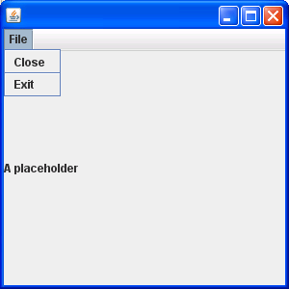

Slide 50
import java.awt.*;
import javax.swing.*;
public class AnotherSeparatorSample
{
public static void main(String args[])
{
JFrame f = new JFrame("JSeparator Sample"); f.setDefaultCloseOperation(JFrame.EXIT_ON_CLOSE);
Container content = f.getContentPane();
content.setLayout(new GridLayout(0, 1));
JLabel above = new JLabel("Above Separator");
content.add(above);
JSeparator separator = new JSeparator();
content.add(separator);
JLabel below = new JLabel("Below Separator");
content.add(below);
f.setSize(300, 100);
f.setVisible(true);
}
}

Slide 52
JToggleButton
A toggle button is two-states button that allows user to switch on and off. To create a toggle button JToggleButton class is used.

Slide 53
Constructors for JToggleButton
JToggleButton( )
Creates a toggle button without text and icon. The state of toggle button is not selected.
JToggleButton(String text)
Creates a toggle button with text
JToggleButton(String text, boolean selected)
Creates a toggle button with text and initialize the state of the toggle button

Slide 54
import java.awt.*;
import javax.swing.*;
public class ToggleButtonSample
{
public static void main(String args[])
{
JFrame f = new JFrame("JToggleButton Sample"); f.setDefaultCloseOperation(JFrame.EXIT_ON_CLOSE);
Container content = f.getContentPane();
content.add(new JToggleButton("North"), BorderLayout.NORTH); content.add(new JToggleButton("East"), BorderLayout.EAST);
content.add(new JToggleButton("West"), BorderLayout.WEST);
content.add(new JToggleButton("Center"),BorderLayout.CENTER);
content.add(new JToggleButton("South"), BorderLayout.SOUTH); f.setSize(300, 200);
f.setVisible(true);
}
}

Slide 55
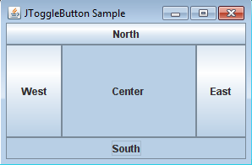

Slide 56
Using Top-Level Containers
Swing provides three generally useful top-level container classes: JFrame, JDialog, and JApplet.
A container has several layers in it. You can think of a layer as a transparent film that overlays the container.
In Java Swing, the layer that is used to hold objects is called the content pane.
Objects are added to the content pane layer of the container.
The getContentPane() method retrieves the content pane layer so that you can add an object to it.

Slide 57
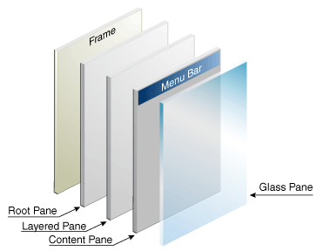

Slide 58
getContentPane()
Returns the contentPane object for this container.
import java.awt.*;
import java.applet.*;
import javax.swing.*;
public class GridLayoutExample extends JApplet
{
public void init()
{
Container c = getContentPane();
c.setLayout(new GridLayout(2, 4));
c.add(new JButton("One"));
c.add(new JButton("Two"));
c.add(new JButton("Three"));
c.add(new JButton("Four"));
c.add(new JButton("Five"));
}
}

Slide 59
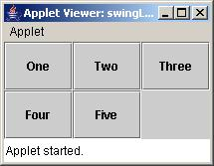

Slide 60
import java.awt.*;
import javax.swing.*;
public class Frame4a
{
public static void main(String[] args)
{
JFrame f = new JFrame("JFrame with a JPanel");
JLabel L = new JLabel("Hello World !");
JPanel P = new JPanel(); // Make a Jpanel
P.add(L);
f.getContentPane().add(P);
f.setSize(400,300);
f.setVisible(true);
}
}

