Slide 1
Chapter 2 (16M)
Sorting

Slide 2
Sorting:

Slide 3
Internal Sorting:

Slide 4
2. External Sorting

Slide 5
Sorting Stability

Slide 6
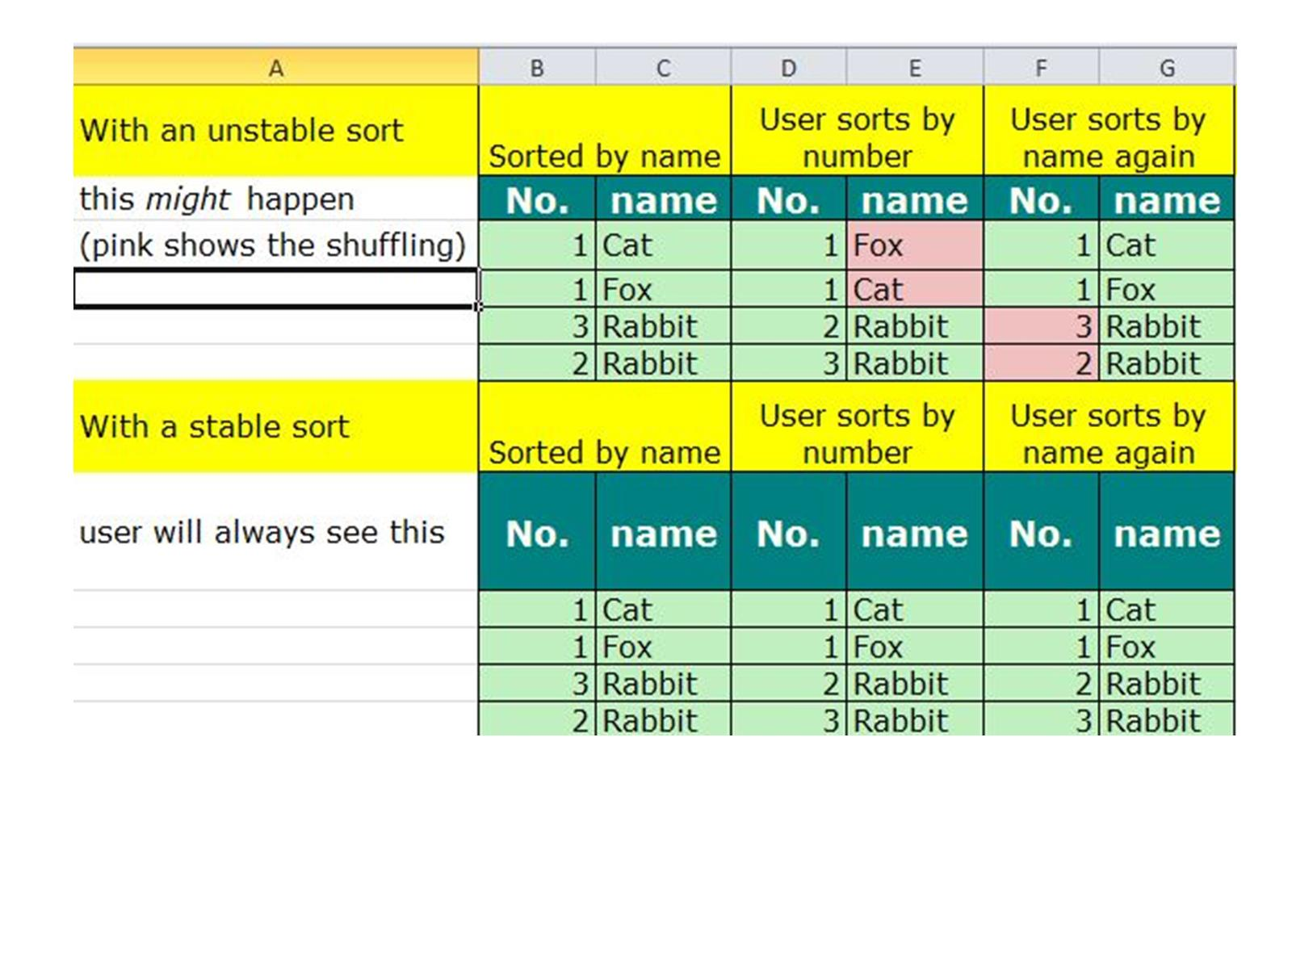

Slide 7
Sorting Techniques:

