Slide 1
LayoutManagers
The LayoutManagers are used to arrange components in a particular manner. LayoutManager is an interface that is implemented by all the classes of layout managers.
There are following classes that represents the layout managers:
java.awt.BorderLayout
java.awt.FlowLayout
java.awt.GridLayout
java.awt.CardLayout
java.awt.GridBagLayout
javax.swing.BoxLayout
javax.swing.GroupLayout
javax.swing.ScrollPaneLayout
javax.swing.SpringLayout etc.
Defined in the AWT
Defined in Swing

Slide 2
Layout of Components
BorderLayout
north, south, west, east & center
FlowLayout
left to right & top down
CardLayout
stack of panels
GridLayout
tabular form (rows & columns)
GridBagLayout
tabular form(variable row heights and column widths)

Slide 3
Use Layout Managers
setLayout(new BorderLayout());
setLayout(new CardLayout(());
setLayout(new FlowLayout());
setLayout(new GridLayout(rows,columns,xgap,ygap));
Default layout managers
Windows (Frames & Dialogs)
BorderLayout
Panels (Applets)
FlowLayout

Slide 4
BorderLayout
The BorderLayout is used to arrange the components in five regions: north, south, east, west and center. Each region (area) may contain one component only. It is the default layout of frame or window.
Five constants for each region:
public static final int NORTH
public static final int SOUTH
public static final int EAST
public static final int WEST
public static final int CENTER

Slide 5
Constructors of BorderLayout class
BorderLayout()
creates a border layout but with no gaps between the components.
JBorderLayout(int hgap, int vgap)
creates a border layout with the given horizontal and vertical gaps between the components.

Slide 6
How to Use BorderLayout?
import java.awt.*;
public class TestBorderLayout {
public static void main(String[] args){
Frame f = new Frame("TestBorderLayout");
f.setSize(200,200);
f.add("North", new Button("North"));
f.add("South", new Button("South"));
f.add("East", new Button("East"));
f.add("West", new Button("West"));
f.add("Center", new Button("Center"));
f.setVisible(true);
}
}

Slide 7
Example of BorderLayout class
import java.awt.*;
import javax.swing.*;
public class Border {
JFrame f;
Border(){
f=new JFrame();
JButton b1=new JButton("NORTH");
JButton b2=new JButton("SOUTH");
JButton b3=new JButton("EAST");
JButton b4=new JButton("WEST");
JButton b5=new JButton("CENTER");
f.add(b1,BorderLayout.NORTH);
f.add(b2,BorderLayout.SOUTH);
f.add(b3,BorderLayout.EAST);
f.add(b4,BorderLayout.WEST);
f.add(b5,BorderLayout.CENTER);
f.setSize(300,300);
f.setVisible(true);
}
public static void main(String[] args) {
new Border();
}
}

Slide 8
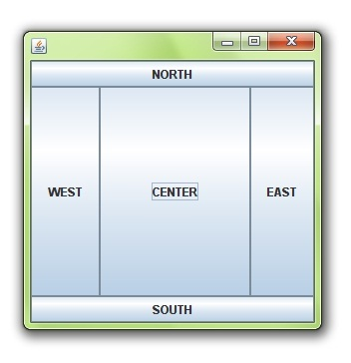

Slide 9
GridLayout
The GridLayout is used to arrange the components in rectangular grid. One component is displayed in each rectangle.

Slide 10
Constructors of GridLayout class
GridLayout()
creates a grid layout with one column per component in a row.
GridLayout(int rows, int columns)
creates a grid layout with the given rows and columns but no gaps between the components.
GridLayout(int rows, int columns, int hgap, int vgap)
creates a grid layout with the given rows and columns alongwith given horizontal and vertical gaps.

Slide 11
How to Use GridLayout?
import java.awt.*;
public class TestGridLayout {
public static void main(String[] args){
Frame f = new Frame("TestGridLayout");
f.setSize(200,200);
f.setLayout(new GridLayout(2,3));
f.add(new Button("Button 1"));
f.add(new Button("Button 2"));
f.add(new Button("Button 3"));
f.add(new Button("Button 4"));
f.add(new Button("Button 5"));
f.setVisible(true);
}
}

Slide 12
Example of GridLayout class
import java.awt.*;
import javax.swing.*;
public class MyGridLayout{
JFrame f;
MyGridLayout(){
f=new JFrame();
JButton b1=new JButton("1");
JButton b2=new JButton("2");
JButton b3=new JButton("3");
JButton b4=new JButton("4");
JButton b5=new JButton("5");
JButton b6=new JButton("6");
JButton b7=new JButton("7");
JButton b8=new JButton("8");
JButton b9=new JButton("9");
f.add(b1);
f.add(b2);
f.add(b3);
f.add(b4);
f.add(b5);
f.add(b6);
f.add(b7);
f.add(b8);
f.add(b9);
f.setLayout(new GridLayout(3,3));
f.setSize(300,300);
f.setVisible(true);
}
public static void main(String[] args) {
new MyGridLayout();
}
}

Slide 13
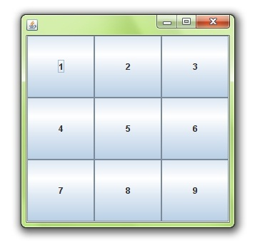

Slide 14
FlowLayout
The FlowLayout is used to arrange the components in a line, one after another (in a flow). It is the default layout of applet or panel.
Fields of FlowLayout class:
public static final int LEFT
public static final int RIGHT
public static final int CENTER
public static final int LEADING
public static final int TRAILING

Slide 15
Constructors of FlowLayout class
FlowLayout()
creates a flow layout with centered alignment and a default 5 unit horizontal and vertical gap.
FlowLayout(int align)
creates a flow layout with the given alignment and a default 5 unit horizontal and vertical gap.
FlowLayout(int align, int hgap, int vgap)
creates a flow layout with the given alignment and the given horizontal and vertical gap.

Slide 16
How to Use FlowLayout?
import java.awt.*;
public class TestFlowLayout {
public static void main(String[] args){
Frame f = new Frame("TestFlowLayout");
f.setSize(200,200);
f.setLayout(new FlowLayout());
f.add(new Button("Button 1"));
f.add(new Button("Button 2"));
f.add(new Button("Button 3"));
f.add(new Button("Button 4"));
f.add(new Button("Button 5"));
f.setVisible(true);
}
}

Slide 17
Example of FlowLayout class
import java.awt.*;
import javax.swing.*;
public class MyFlowLayout{
JFrame f;
MyFlowLayout(){
f=new JFrame();
JButton b1=new JButton("1");
JButton b2=new JButton("2");
JButton b3=new JButton("3");
JButton b4=new JButton("4");
JButton b5=new JButton("5");
f.add(b1);
f .add(b2);
f.add(b3);
f.add(b4);
f.add(b5);
f.setLayout(new FlowLayout(FlowLayout.RIGHT));
//setting flow layout of right alignment
f.setSize(300,300);
f.setVisible(true);
}
public static void main(String[] args) {
new MyFlowLayout();
}
}

Slide 18
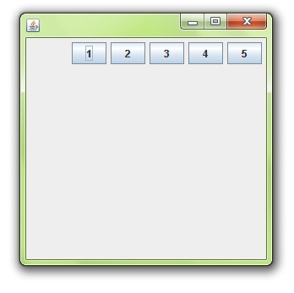

Slide 19
CardLayout class
The CardLayout class manages the components in such a manner that only one component is visible at a time. It treats each component as a card that is why it is known as CardLayout.
Constructors of CardLayout class
CardLayout()
creates a card layout with zero horizontal and vertical gap.
CardLayout(int hgap, int vgap)
creates a card layout with the given horizontal and vertical gap.

Slide 20
Commonly used methods CardLayout
public void next(Container parent)
It is used to flip to the next card of the given container.
public void previous(Container parent)
It is used to flip to the previous card of the given container.
public void first(Container parent)
It is used to flip to the first card of the given container.
public void last(Container parent)
It is used to flip to the last card of the given container.
public void show(Container parent, String name)
It is used to flip to the specified card with the given name.

Slide 21
How to Use CardLayout?
import java.awt.*;
public class TestCardLayout {
public static void main(String[] args){
Frame f = new Frame("TestCard Layout");
f.setSize(200,200);
f.setLayout(new CardLayout());
f.add("GraphicsPanel",new GraphicsPanel());
f.add("LabelPanel",new LabelPanel());
f.add("ButtonPanel",new ButtonPanel());
f.setVisible(true);
}
}

Slide 22
Example of CardLayout class
import java.awt.*;
import java.awt.event.*;
import javax.swing.*;
public class CardLayoutExample extends
JFrame implements ActionListener{
CardLayout card;
JButton b1,b2,b3;
Container c;
CardLayoutExample(){
c=getContentPane();
card=new CardLayout(40,30);
c.setLayout(card);
b1=new JButton("Apple");
b2=new JButton("Boy");
b3=new JButton("Cat");
b1.addActionListener(this);
b2.addActionListener(this);
b3.addActionListener(this);
c.add("a",b1);
c.add("b",b2);
c.add("c",b3);
}
public void actionPerformed(ActionEvent e)
{
card.next(c);
}
public static void main(String[] args)
{
CardLayoutExample cl=new CardLayoutExample();
cl.setSize(400,400);
cl.setVisible(true);
cl.setDefaultCloseOperation(EXIT_ON_CLOSE);
}
}

Slide 23
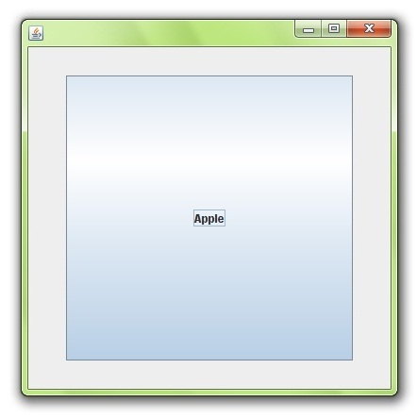

Slide 24
GridBagLayout class
The GridBagLayout class is a flexible layout manager that aligns components vertically and horizontally, without requiring that the components be of the same size. Each GridBagLayout object maintains a dynamic rectangular grid of cells, with each component occupying one or more cells, called its display area.

Slide 25
Constructor of GridBagLayout class
GridBagLayout()
Creates a grid bag layout manager.

Slide 26
Some of the information that the GridBagLayout needs to know about an object are:
row and column
number of cells spanned
placement within its space
stretch and shrink values
This information is stored in an object of type GridBagContstraints and is associated with a component using
setContraints(Component, GridBagContraints)
This causes the layout manager to make a copy of the constraints and associate them with the object. Therefore you only need one of these GridBagContraints objects.

Slide 27
GridBagConstraints
The following is a complete list of all of the constraints:
anchor determines position in the display area
fill determines if a component is stretched to fill the area
gridheight and gridwidth determine the number of rows and columns in the component's area
gridx and gridy determine the position of the component's area.
insets determine a border around a component's area.
ipadx and ipady allows the minimum or preferred size of a component to be adjusted.
weightx and weighty determine the sizes of the rows and columns of the grids.

Slide 28
Example of GridBagLayout class
import java.awt.*;
import java.awt.event.*;
import java.applet.*;
public class GB01 extends Applet
implements ActionListener {
Button B1 = new Button("Button 1");
Button B2 = new Button("Button 2");
GridBagLayout gridbag;
public void init() {
setBackground(Color.yellow);
gridbag = new GridBagLayout();
GridBagConstraints c = new GridBagConstraints();
setLayout(gridbag);
c.weightx = 1;
c.weighty = 1;
c.gridx = 0;
c.gridy = 0;
c.anchor = GridBagConstraints.SOUTHWEST;
gridbag.setConstraints(B1,c);
add(B1);
c.weightx = 0;
c.gridx = 1;
c.anchor = GridBagConstraints.NORTH;
c.fill = GridBagConstraints.BOTH;
gridbag.setConstraints(B2,c);
add(B2);
B1.addActionListener(this);
B2.addActionListener(this);
}
public void actionPerformed(ActionEvent e) {
repaint();
}
}
/*<applet code=GB01.class width=200 height=200> </applet>*/

Slide 29
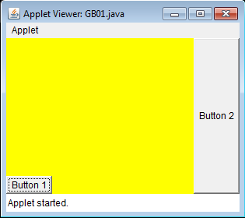

Slide 30
Layout Manager Heuristics
null
FlowLayout
GridLayout
none, programmer sets x,y,w,h
Left to right,
Top to bottom
BorderLayout
CardLayout
GridBagLayout
n
c
One at a time
w
e
JButton
s

