Slide 1




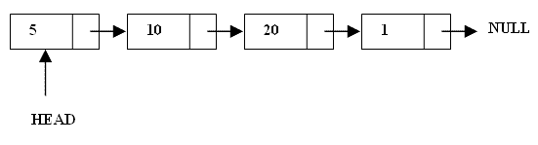
What are Linked Lists
A linked list is a linear data structure.
Nodes make up linked lists.
Nodes are structures made up of data and a pointer to another node.
Usually the pointer is called next.

Slide 2

Arrays Vs Linked Lists
Arrays | Linked list
Fixed size: Resizing is expensive | Dynamic size
Insertions and Deletions are inefficient: Elements are usually shifted | Insertions and Deletions are efficient: No shifting
Random access i.e., efficient indexing | No random access → Not suitable for operations requiring accessing elements by index such as sorting
No memory waste if the array is full or almost full; otherwise may result in much memory waste. | Since memory is allocated dynamically(acc. to our need) there is no waste of memory.
Sequential access is faster [Reason: Elements in contiguous memory locations] | Sequential access is slow [Reason: Elements not in contiguous memory locations]

Slide 3

Types of lists
 There are two basic types of linked list
Singly Linked list
Doubly linked list

Slide 4

Singly Linked List
Each node has only one link part
Each link part contains the address of the next node in the list
Link part of the last node contains NULL value which signifies the end of the node

Slide 5






Schematic representation
 Here is a singly-linked list (SLL):
myList
a
b
c
d
Each node contains a value(data) and a pointer to the next node in the list
myList is the header pointer which points at
the first node in the list

Slide 6

Basic Operations on a list
Creating a List
Inserting an element in a list
Deleting an element from a list
Searching a list
Reversing a list

Slide 7

Creating a node
struct node{
int data; node*next;
}*start;
start=NULL ;
// A simple node of a linked list
//start points at the first node
initialised to NULL at beginning

Slide 8


node* create( int num) //say num=1 is passed from main
{
node*ptr;
ptr= new node; //memory allocated dynamically if(ptr==NULL)
‘OVERFLOW’ // no memory available
exit(1); else
{
ptr->data=num; ptr->next=NULL; return ptr;
}
}

Slide 9

To be called from main() as:-
void main()
{
node* ptr; int data; cin>>data;
ptr=create(data);
}

Slide 10

Inserting the node in a SLL
There are 3 cases here:-
Insertion at the beginning
Insertion at the end
Insertion after a particular node

Slide 11

Insertion at the beginning
There are two steps to be followed:-
Make the next pointer of the node point towards the first node of the list
Make the start pointer point towards this new node
If the list is empty simply make the start pointer point towards the new node;

Slide 12

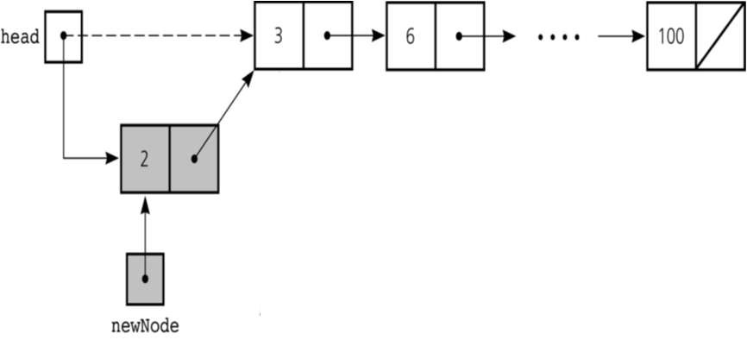

Slide 13

void insert_beg(node* p)
{
node* temp;
if(start==NULL)
{
start=p;
//if the list is empty
cout<<”\nNode inserted successfully at the beginning”;
}
else {
temp=start; start=p;
p->next=temp; //making new node point at
the first node of the list
}
}

Slide 14
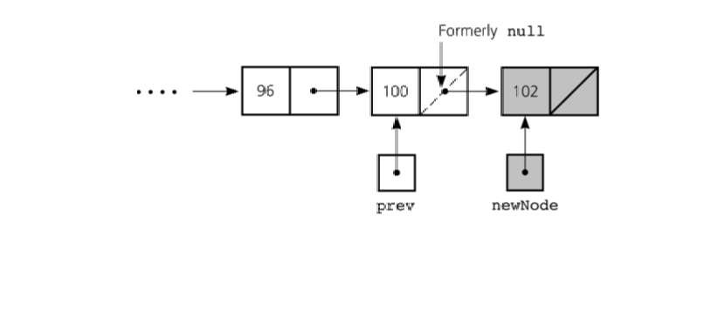
Inserting at the end
Here we simply need to make the next pointer of the last node point to the new node

Slide 15

void insert_end(node* p)
{
node *q=start;
if(start==NULL)
{
start=p;
cout<<”\nNode inserted successfully at the end…!!!\n”;
}
else{
while(q->link!=NULL) q=q->link;
q->next=p;
}
}

Slide 16

Inserting after an element
Here we again need to do 2 steps :-
Make the next pointer of the node to be inserted point to the next node of the node after which you want to insert the node
Make the next pointer of the node after which the node is to be inserted, point to the node to be inserted

Slide 17

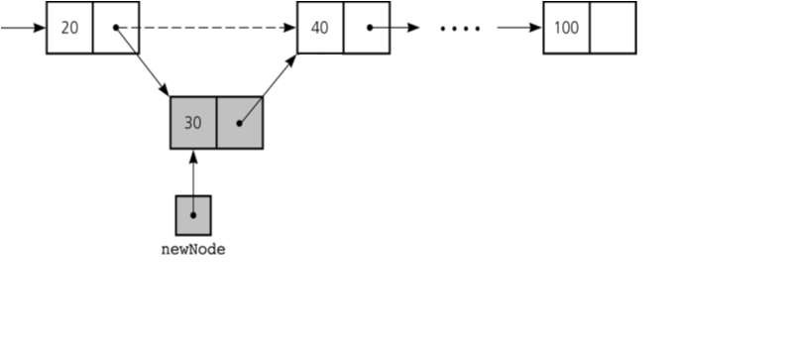

Slide 18

void insert_after(int c,node* p)
{
node* q; q=start;
for(int i=1;i<c;i++)
{
q=q->link;
if(q==NULL)
cout<<”Less than “<<c<<” nodes in the list…!!!”;
}
p->link=q->link; q->link=p;
cout<<”\nNode inserted successfully”;
}

Slide 19

Deleting a node in SLL
Here also we have three cases:-
Deleting the first node
Deleting the last node
Deleting the intermediate node

Slide 20



Deleting the first node
Here we apply 2 steps:-
Making the start pointer point towards the 2nd node
Deleting the first node using delete keyword
start
one
two
three

Slide 21

void del_first()
{
if(start==NULL) cout<<”\nError……List is empty\n”; else
{
node* temp=start; start=temp->link; delete temp;
cout<<”\nFirst node deleted successfully….!!!”;
}
}

Slide 22



Deleting the last node
Here we apply 2 steps:-
Making the second last node’s next pointer point to NULL
Deleting the last node via delete keyword
start
node1 node2 node3

Slide 23

void del_last()
{
if(start==NULL) cout<<”\nError….List is empty”; else
{
node* q=start;
while(q->link->link!=NULL) q=q->link;
node* temp=q->link; q->link=NULL; delete temp;
cout<<”\nDeleted successfully…”;
}
}
}

Slide 24

Deleting a particular node
Here we make the next pointer of the node previous to the node being deleted ,point to the successor node of the node to be deleted and then delete the node using delete keyword
node1 node2
node3
To be deleted

Slide 25

void del(int c)
{
node* q=start;
for(int i=2;i<c;i++)
{
q=q->link;
if(q==NULL)
cout<<”\nNode not found\n”;
}
if(i==c)
{
node* p=q->link; q->link=p->link; delete p;
//node to be deleted
//disconnecting the node p
cout<<“Deleted Successfully”;
}
}

Slide 26

Searching a SLL
Searching involves finding the required element in the list
We can use various techniques of searching like linear search or binary search where binary search is more efficient in case of Arrays
But in case of linked list since random access is not available it would become complex to do binary search in it
We can perform simple linear search traversal

Slide 27

In linear search each node is traversed till the data in
the node matches with the required value
void search(int x)
{
node*temp=start; while(temp!=NULL)
{
if(temp->data==x)
{
cout<<“FOUND ”<<temp->data; break;
}
temp=temp->next;
}
}

Slide 28

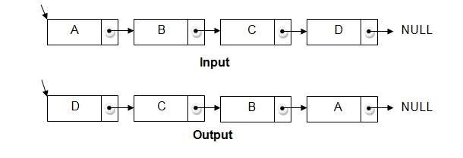
Reversing a linked list
We can reverse a linked list by reversing the direction of the links between 2 nodes

Slide 29

We make use of 3 structure pointers say p,q,r
At any instant q will point to the node next to p and r will point to the node next to q
Head
P
qp
rq
NULL
NULL
For next iteration p=q and q=r
At the end we will change head to the last node

Slide 30

Code
void reverse()
{
node*p,*q,*r; if(start==NULL)
{
cout<<"\nList is empty\n";
return;
}
p=start; q=p->link;
p->link=NULL;
while(q!=NULL)
{
r=q->link; q->link=p; p=q;
q=r;
}
start=p;
cout<<"\nReversed successfully";
}

Slide 31

COMPLEXITY OF VARIOUS OPERATIONS IN ARRAYS AND SLL
Operation | ID-Array Complexity | Singly-linked list Complexity
Insert at beginning | O(n) | O(1)
Insert at end | O(1) | O(1) if the list has tail reference O(n) if the list has no tail reference
Insert at middle | O(n) | O(n)
Delete at beginning | O(n) | O(1)
Delete at end | O(1) | O(n)
Delete at middle | O(n): O(1) access followed by O(n) shift | O(n): O(n) search, followed by O(1) delete
Search | O(n) linear search O(log n) Binary search | O(n)
Indexing: What is the element at a given position k? | O(1) | O(n)

Slide 32

Doubly Linked List
1. Doubly linked list is a linked data structure that consists of a set of sequentially linked records called nodes.
2 .
Each node contains three fields ::
-: one is data part which contain data only.
-:two other field is links part that are point or references to the previous or to the next node in the sequence of nodes.
3.
The beginning and ending nodes' previous and next links, respectively, point to some kind of terminator, typically a sentinel node or null to facilitate traversal of the list.

Slide 33

NODE
previous | data | next
A
B
C
NULL | 11 | 786
200
656
400
786 | 777 | NULL
200
786
400
A doubly linked list contain three fields: an integer value, the link to the next node, and the link to the previous node.

Slide 34
DLL’s compared to SLL’s
Advantages:
  Can be traversed in either direction (may be essential for some programs)
  Some operations, such as deletion and inserting before a node, become easier
Disadvantages:
  Requires more space
  List manipulations are slower (because more links must be changed)
  Greater chance of having bugs (because more links must be manipulated)

Slide 35

Structure of DLL
struct node
{
int data; node*next; node*previous;
};
//holds the address of previous node
previous.
.Data
.next
inf

Slide 36



Inserting at beginning

Slide 37

void insert_beg(node *p)
{
if(start==NULL)
{
start=p;
cout<<"\nNode inserted successfully at the beginning\m";
}
else
{
node* temp=start;
start=p;
temp->previous=p; new node
p->next=temp;
1st node
//making 1st node’s previous point to the
//making next of the new node point to the
cout<<"\nNode inserted successfully at the beginning\n";
}

Slide 38

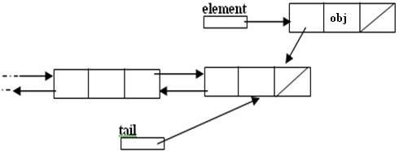
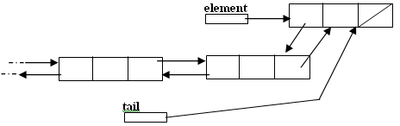
Inserting at the end

Slide 39

void insert_end(node* p)
{
if(start==NULL)
{
start=p;
cout<<"\nNode inserted successfully at the end";
}
else
{
node* temp=start; while(temp->next!=NULL)
{
temp=temp->next;
}
temp->next=p;
p->previous=temp;
cout<<"\nNode inserted successfully at the end\n";
}
}

Slide 40

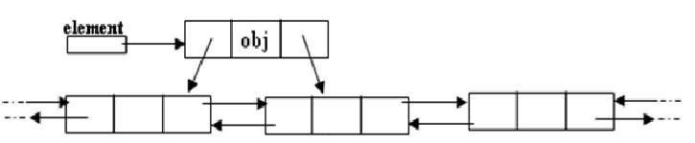
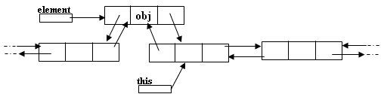
Inserting after a node
Making next and previous pointer of the node to be inserted point accordingly
Adjusting the next and previous pointers of the nodes b/w which the new node accordingly

Slide 41

void insert_after(int c,node* p)
{
temp=start;
for(int i=1;i<c-1;i++)
{
temp=temp->next;
}
p->next=temp->next; temp->next->previous=p; temp->next=p;
p->previous=temp; cout<<"\nInserted successfully";
}

Slide 42



Deleting a node
Node deletion from a DLL involves changing two links
In this example,we will delete node b
myDLL
a
b c
We don’t have to do anything about the links in node b
Garbage collection will take care of deleted nodes
Deletion of the first node or the last node is a special case

Slide 43

void del_at(int c)
{
node*s=start;
{
for(int i=1;i<c-1;i++)
{
s=s->next;
}
node* p=s->next; s->next=p->next;
p->next->previous=s; delete p;
cout<<"\nNode number "<<c<<" deleted successfully";
}
}
}

Slide 44

APPLICATIONS OF LINKED LIST
Applications that have an MRU list (a linked list of file names)
The cache in your browser that allows you to hit the BACK button (a linked list of URLs)
Undo functionality in Photoshop or Word (a linked list of state)
A stack, hash table, and binary tree can be implemented using a doubly linked list.

Slide 45

Polynomials
Array Implementation:
p1(x) = 8x³ + 3x² + 2x + 6
p2(x) = 23x⁴ + 18x - 3
p1(x)
p2(x)
6 | 2 | 3 | 8
-3 | 18 | 0 | 0 | 23
0
2
0
2
4
Index represents exponents

Slide 46

This is why arrays aren’t good to represent polynomials:
p3(x) = 16x²¹ - 3x⁵ + 2x + 6
6 | 2 | 0 | 0 | -3 | 0 | ………… | 0 | 16
WASTE OF SPACE!

Slide 47

Advantages of using an Array:
  only good for non-sparse polynomials.
  ease of storage and retrieval.
Disadvantages of using an Array:
  have to allocate array size ahead of time.
  huge array size required for sparse polynomials. Waste of space and runtime.

Slide 48


Polynomial Representation
  Linked list Implementation:
  p1(x) = 23x⁹ + 18x⁷ + 41x⁶ + 163x⁴ + 3
  p2(x) = 4x⁶ + 10x⁴ + 12x + 8
P1
3
23
9
18 7 41 6 18 7
TAIL (contains pointer)
0
P2
4
10
6
4 12 1 8 0
NODE (contains coefficient & exponent)

Slide 49

Advantages of using a Linked list:
  save space (don’t have to worry about sparse polynomials) and easy to maintain
  don’t need to allocate list size and can declare nodes (terms) only as needed
Disadvantages of using a Linked list :
  can’t go backwards through the list
  can’t jump to the beginning of the list from the end.

Slide 50



Polynomials
A(x)
^{e}m 1
a_{m 1} x a_{m}
^{e}m 2 ^{e}0
₂ x ... a₀ x
Representation
struct polynode {
int coef;
int exp;
struct polynode * next;
};
typedef struct polynode *polyptr;
coef | exp | next

Slide 51

Adding polynomials using a Linked list representation: (storing the result in p3)
To do this, we have to break the process down to cases:
Case 1: exponent of p1 > exponent of p2
  Copy node of p1 to end of p3. [go to next node]
Case 2: exponent of p1 < exponent of p2
  Copy node of p2 to end of p3. [go to next node]

Slide 52

Case 3: exponent of p1 = exponent of p2
  Create a new node in p3 with the same exponent and with the sum of the coefficients of p1 and p2.

Slide 53

Adding Polynomials
3 14
2 8 1 0
-3 10 10 6
a
8 14
b
11 14
a->expon == b->expon
d
3 14
2 8
-3 10
1 0
a
8 14
11 14
10 6
b
-3 10
a->expon < b->expon

Slide 54

3
14
2
8
1
0
a
8
14
-3
10
10
6
b
11
14
-3
10
2
8
d
a->expon > b->expon

Slide 55


THANK YOU

