Slide 1
AWT Components
Java AWT components are platform-dependent i.e. components are displayed according to the view of operating system. AWT is heavyweight i.e. its components are using the resources of OS.
The java.awt package provides classes for AWT api such as TextField, Label, TextArea, RadioButton, CheckBox, Choice, List etc.

Slide 2
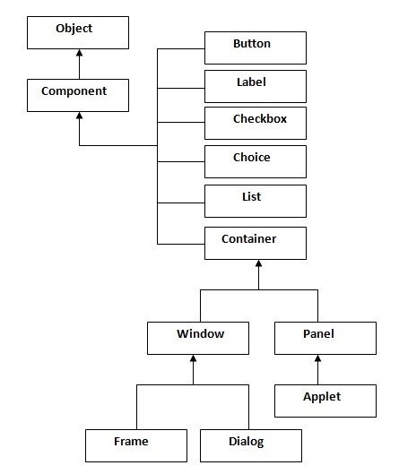
Java AWT Hierarchy
The hierarchy of Java AWT classes are given below.
Note: There are more classes, however, these are what are covered in this chapter

Slide 3
Component
Component is the superclass of most of the displayable classes defined within the AWT. Note: it is abstract.
MenuComponent is another class which is similar to Component except it is the superclass for all GUI items which can be displayed within a drop-down menu.
The Component class defines data and methods which are relevant to all Components
setBounds
setSize
setLocation
setFont
setEnabled
setVisible
setForeground -- color
setBackground -- color
Notes:
The Component class contains the common features to all items which can be displayed in a GUI. Often, these items are called widgets. In the AWT, all widgets are components and, as such, inherit all the data and methods of the Component class.

Slide 4
Container
The Container is a component in AWT that can contain another components like buttons, textfields, labels etc. The classes that extends Container class are known as container such as Frame, Dialog and Panel.
For a component to be placed on the screen, it must be placed within a Container
The Container class defined all the data and methods necessary for managing groups of Components
add
getComponent
getMaximumSize
getMinimumSize
getPreferredSize
remove
removeAll

Slide 5
Window
The window is the container that have no borders and menu bars. You must use frame, dialog or another window for creating a window.
Top level window without
borders,
menubar
show() makes window visible
toFront(), toBack()
pack() resizes window to fit components in it
dispose() frees resources when window is not needed
Example use: pop-up menu

Slide 6
Panel
The Panel is the container that doesn't contain title bar and menu bars. It can have other components like button, textfield etc.
Alternative to window
e.g., for display of Applet in Web browser
A Panel is a rectangular Container whose sole purpose is to hold and manage components within a GUI.
Panel p1 = new Panel();
p1.add(new Button("Ok"));
aPanel.add(new Button("Cancel"));
Frame f = new Frame("Button Test");
f.setSize(100,100);
f.setLocation(10,10);
f.add(p1);

Slide 7
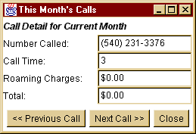
Frame
The Frame is the container that contain title bar and can have menu bars. It can have other components like button, textfield etc.
A window with title, menubar, icon, cursor

Slide 8
Useful Methods of Component class
Method | Description
public void add(Component c) | inserts a component on this component.
public void setSize(int width,int height) | sets the size (width and height) of the component.
public void setLayout(LayoutManager m) | defines the layout manager for the component.
public void setVisible(boolean status) | changes the visibility of the component, by default false.

Slide 9
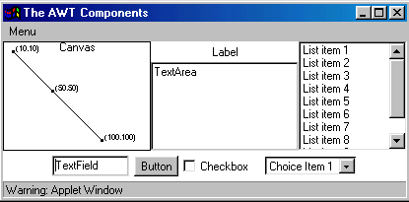
AWT Components

Slide 10
Using AWT Components
Component
Canvas
Scrollbar
Button
Checkbox
Label
List
Choice
TextComponent
TextArea
TextField
Component
Container
Panel
Window
Dialog
FileDialog
Frame
MenuComponent
MenuItem
Menu

Slide 11
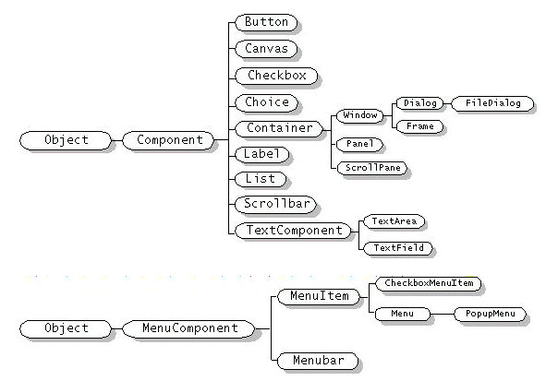

Slide 12
Frame
import java.awt.*;
public class TestFrame extends Frame {
public TestFrame(String title){
super(title);
}
public static void main(String[] args){
Frame f = new TestFrame("TestFrame");
f.setSize(400,400);
f.setLocation(100,100);
f.show();
}
}

Slide 13
How to Use Buttons?
Button
This class represents a push-button which displays some specified text.
When a button is pressed, it notifies its Listeners. (More about Listeners in the next chapter).
To be a Listener for a button, an object must implement the ActionListener Interface.
public class TestButton extends Frame {
public TestButton(String title){
super(title);
Button hw = new Button("Hello World!");
add(hw);
}
….
}

Slide 14
Label
Displays 1 line of text (read-only) This class is a Component which displays a single line of text.
Labels are read-only. That is, the user cannot click on a label to edit the text it displays.
Text can be aligned within the label

Slide 15
How to Use Labels?
public class TestLabel extends Frame {
public TestLabel(String title){
super(title);
Label label1 = new Label();
label1.setText("Label1");
Label label2 = new Label("Label2");
label2.setAlignment(Label.CENTER);
Label label3 = new Label("Label3");
add(label1,"North");
add(label2,"Center");
add(label3,"South");
}
}

Slide 16
Checkbox
This class represents a GUI checkbox with a textual label.
The Checkbox maintains a boolean state indicating whether it is checked or not.
Checkboxgroup
If a Checkbox is added to a CheckBoxGroup, it will behave like a radio button.

Slide 17
How to Use Checkboxes?
public class TestCheckbox extends Frame {
public TestCheckbox(String title){
super(title);
CheckboxGroup cbg = new CheckboxGroup();
Checkbox cb1 = new Checkbox("American Express",cbg,false);
Checkbox cb2 = new Checkbox("Visa",cbg,false);
Checkbox cb3 = new Checkbox("Mastercard",cbg,true);
add(cb1,"North");
add(cb2,"Center");
add(cb3,"South");
}
…
}

Slide 18
Choice
This class represents a dropdown list of Strings.
Similar to a list in terms of functionality, but displayed differently.
Only one item from the list can be selected at one time and the currently selected element is displayed.
⇒

Slide 19
How to Use Choices?
public class TestChoice extends Frame {
public TestChoice(String title){
super(title);
Choice choice = new Choice();
choice.add("ichi");
choice.add("ni");
choice.add("san");
add(choice);
}

Slide 20
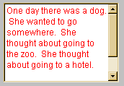
TextComponent
This class displays optionally editable text.
This class inherits several methods from TextComponent.
This is one of the most commonly used Components in the AWT
Can be editable (getText() returns text)
Can be selectable
TextField
One line TextComponent
setEchoCharacter() allows password entry
TextArea
Multiline TextComponent

Slide 21
How to Use TextField & TextArea
public class TestText extends Frame {
public TestText(String title){
super(title);
TextField textField = new TextField(20);
TextArea textArea = new TextArea(5, 20);
textArea.setEditable(false);
textField.setText("TextField");
textArea.setText("TextArea Line1 \n TextArea Line2");
add(textField,"North");
add(textArea,"South");
}
…
}

Slide 22
List
Displays list of strings as N rows
Adds scrollbar if necessary
Allows single and multiple selection
Method to return selected item indexes

Slide 23
How to Use Lists?
public class TestList extends Frame {
public TestList(String title){
super(title);
List l = new List(2, true); //prefer 2 items visible
l.add("zero");
l.add("uno");
l.add("dos");
l.add("tres");
l.add("cuatro");
l.add("cinco");
l.add("seis");
l.add("siete");
l.add("ocho");
l.add("nueve");
add(l);
}

Slide 24
Scrollbar
You specify orientation (horz, vert, and min/max range)
Event returned specifies
#lines or pages to scroll, or
absolute position to scroll to

Slide 25
Scrollbars and Sliders
Constructors
Scrollbar
Creates a vertical scrollbar
The “bubble” (or “thumb,” the part that actually moves) size defaults to 10% of the trough length
The internal min and max values are set to zero
Scrollbar(int orientation)
Similar to above; specify a horizontal (Scrollbar.HORIZONTAL) or vertical (Scrollbar.VERTICAL) scrollbar
Scrollbar(int orientation, int initialValue, int bubbleSize, int min, int max)
Creates a horizontal or vertical “slider” for interactively selecting values
Specify a customized bubble thickness and a specific internal range of values
Bubble thickness is in terms of the scrollbar’s range of values, not in pixels, so if max minus min was 5, a bubble size of 1 would specify 20% of the trough length

Slide 26
Scollbars: Example
public class Scrollbars extends Applet {
public void init() {
int i;
setLayout(new GridLayout(1, 2));
Panel left = new Panel(), right = new Panel();
left.setLayout(new GridLayout(10, 1));
for(i=5; i<55; i=i+5) {
left.add(new Scrollbar(Scrollbar.HORIZONTAL,
50, i, 0, 100));
}
right.setLayout(new GridLayout(1, 10));
for(i=5; i<55; i=i+5) {
right.add(new Scrollbar(Scrollbar.VERTICAL,
50, i, 0, 100));
}
add(left);
add(right);
}
}

Slide 27
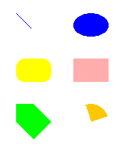
How to Use Canvases and Graphics Primitives?
For drawing geometric shapes, texts, and images
An abstract class
the extended class must override paint()
Line
RoundRectangle
Polygon
Oval
Rectangle
Arc

Slide 28
drawLine(x1,y1,x2,y2)
class MyCanvas extends Canvas {
public void paint(Graphics g){
g.setColor(Color.blue);
int x1 = 161,
y1 = 186,
x2 = 181,
y2 = 206;
g.drawLine(x1,y1,x2,y2);
}
(x1,y1)
(x2,y2)

Slide 29
fillOval(x,y,w,h) drawOval(x,y,w,h)
g.setColor(Color.blue);
{
int x = 239,
y = 186,
w = 48,
h = 32;
g.fillOval(x,y,w,h);
}

Slide 30
fillPolygon(int[] xs, int[] ys) drawPolygon(int[] xs, int[] ys)
g.setColor(Color.green);
{
int xs[] = {161,161,185,209,185,161};
int ys[] = {310,334,358,334,310,310};
g.fillPolygon(xs,ys,6);
}

Slide 31
fillRect(x,y,w,h) drawRect(x,y,w,h)
g.setColor(Color.pink);
{
int x = 239,
y = 248,
w = 48,
h = 32;
g.fillRect(x,y,w,h);
}

Slide 32
fillRoundRect(x,y,w,h,rw,rh) drawRoundRect(x,y,w,h,rw,rh)
g.setColor(Color.yellow);
{
int x = 161,
y = 248,
w = 48,
h = 32,
roundW = 25,
roundH = 25;
g.fillRoundRect(x,y,w,h,roundW,roundH);
}

Slide 33
fillArc(x,y,w,h,sa,a) drawArc(x,y,w,h,sa,a)
g.setColor(Color.orange);
{
int x = 239,
y = 310,
w = 48,
h = 48,
startAngle = 20,
angle = 90;
g.fillArc(x,y,w,h,startAngle,angle);
}

